Slide 1

Unit-2 Sequence and Series
Mathematics-I
GTU#(3110014)
Prof. Dhvanik H. Zala
Humanities & Science
dhvanik.zala@darshan.ac.in
8238588865

Slide 2
OUTLINE
Introduction
Method:4
Geometric Series
Method:5
Telescoping Series
Method:6
Zero Test
Method:7
Combining Series
Method:8
Integral Test

Slide 3

OUTLINE
Method:9
Direct Comparison Test
Method:10
Limit Comparison Test
Method:11
D’Alembert’s Ratio Test
Method:13
Cauchy’s $n^{th}$ Root Test
Method:14
Leibnitz’s Test
Method:15
Absolute Convergent Series

Slide 4


OUTLINE
Method:16
Conditionally Convergent Series
Method:17
Power Series
Method:18
$1^{st}$ form of Taylor’s Series
Method:19
$2^{nd}$ form of Taylor’s Series
Method:20
Maclaurin’s Series

Slide 5

Introduction

Slide 6
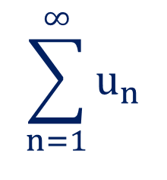

Series
Infinite Series
If $u_{1}, u_{2}, …, u_{n}, …$ is an infinite sequence of real numbers, then the sum
of terms of the sequence, $u_{1}+u_{2}+…+u_{n}+…$ is called an infinite
series.
$$\sum_{n=1}^{∞}{u_{n}}$$
$$or\sum{u_{n}}$$
Notation

Slide 7











Series
Sequence of Partial Sums
Let $\sum{u_{n}}$ be a given infinite series.
$$\left\{S_{n}\right\}=$$
$$\left\{S_{1}, S_{2},…, S_{n}\right\}$$
Consider
$$S_{1}=u_{1}$$
$$S_{2}=u_{1}+u_{2}$$
$$u_{1}$$
$$u_{1}+u_{2}$$
$$S_{3}=u_{1}+u_{2}+u_{3}$$
$$⋮$$
$$u_{1}+u_{2}+…+u_{n}$$
$$S_{n}=u_{1}+u_{2}+…+u_{n}.$$
Then $\left\{S_{n}\right\}$ defined as above is called the sequence of partial sums of
the given series.

Slide 8
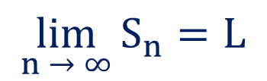

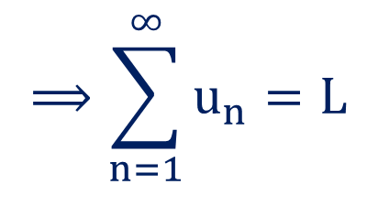
Series
Convergence of an infinite series
An infinite series $\sum{u_{n}}$ is said to be convergent if the sequence of partial
sums $\{S_{n}\}$ converges to some finite number $L.$
$$⟹\sum_{n=1}^{∞}{u_{n}}=L$$
$$\lim_{n → ∞}{S_{n}=L}$$
If the sequence of partial sums $\{S_{n}\}$ diverges, then the series is said
to be divergent.

Slide 9
Method:4
Geometric series

Slide 10

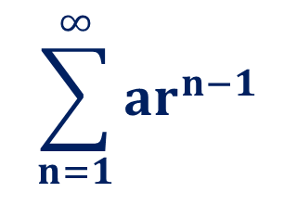

Infinite Series
Geometric Series
$$\sum_{n=1}^{∞}{ar^{n−1}}$$
An infinite series of the form
$$=a+ar+{ar}^{2}+ar^{3}+…$$
is
known as Geometric Series
where, ‘$r$’ is common ratio and ‘$a$’ is the first term.

Slide 11
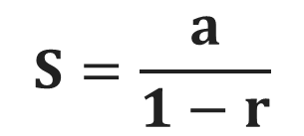
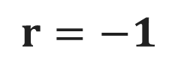
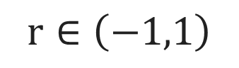
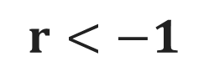
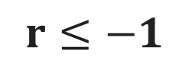

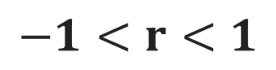
Test for Geometric Series
$$r∈\left(−1,1\right)$$
Geometric Series
Convergent
Divergent
if
if
$$−1<r<1$$
Oscillating
$$r≥1$$
if
$$S=\frac{a}{1−r}$$
$$r≤−1$$
$$r=−1$$
$$r<−1$$
then
then
Finitely oscillating
Infinitely oscillating

Slide 12
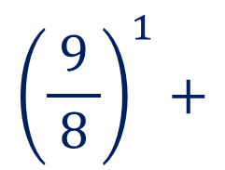
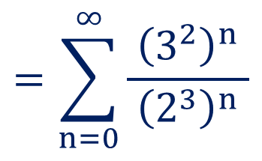
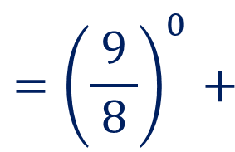
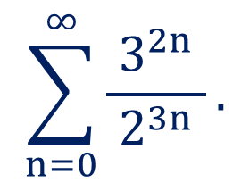
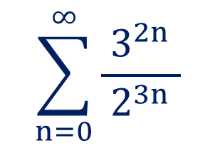
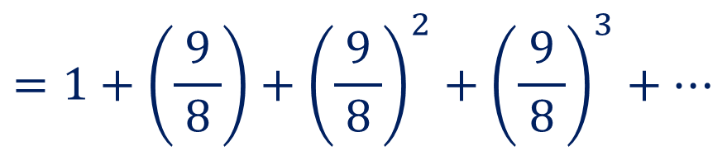
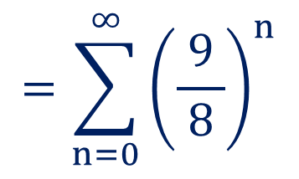
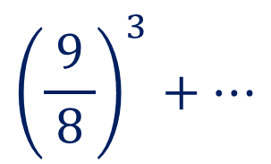
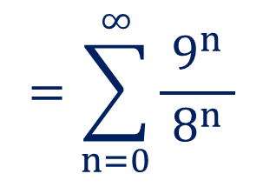
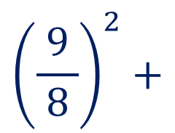
Method:4 Geometric Series
$$\sum_{n=0}^{∞}{\frac{3^{2n}}{ 2^{3n} }}.$$
Example:1
Test the convergence of
$$\sum_{n=0}^{∞}{\frac{3^{2n}}{ 2^{3n} }}$$
$$=\sum_{n=0}^{∞}{{\left(\frac{9}{ 8 }\right)}^{n}}$$
Solution:
Here,
$${=\left(\frac{9}{ 8 }\right)}^{0}+$$
$${\left(\frac{9}{ 8 }\right)}^{1}+$$
$${\left(\frac{9}{ 8 }\right)}^{2}+$$
$${\left(\frac{9}{ 8 }\right)}^{3}+…$$
$$=\sum_{n=0}^{∞}{\frac{{\left(3^{2}\right)}^{n}}{ {\left(2^{3}\right)}^{n} }}$$
$$=1+\left(\frac{9}{ 8 }\right)+{\left(\frac{9}{ 8 }\right)}^{2}+{\left(\frac{9}{ 8 }\right)}^{3}+…$$
$$=\sum_{n=0}^{∞}{\frac{9^{n}}{ 8^{n} }}$$

Slide 13
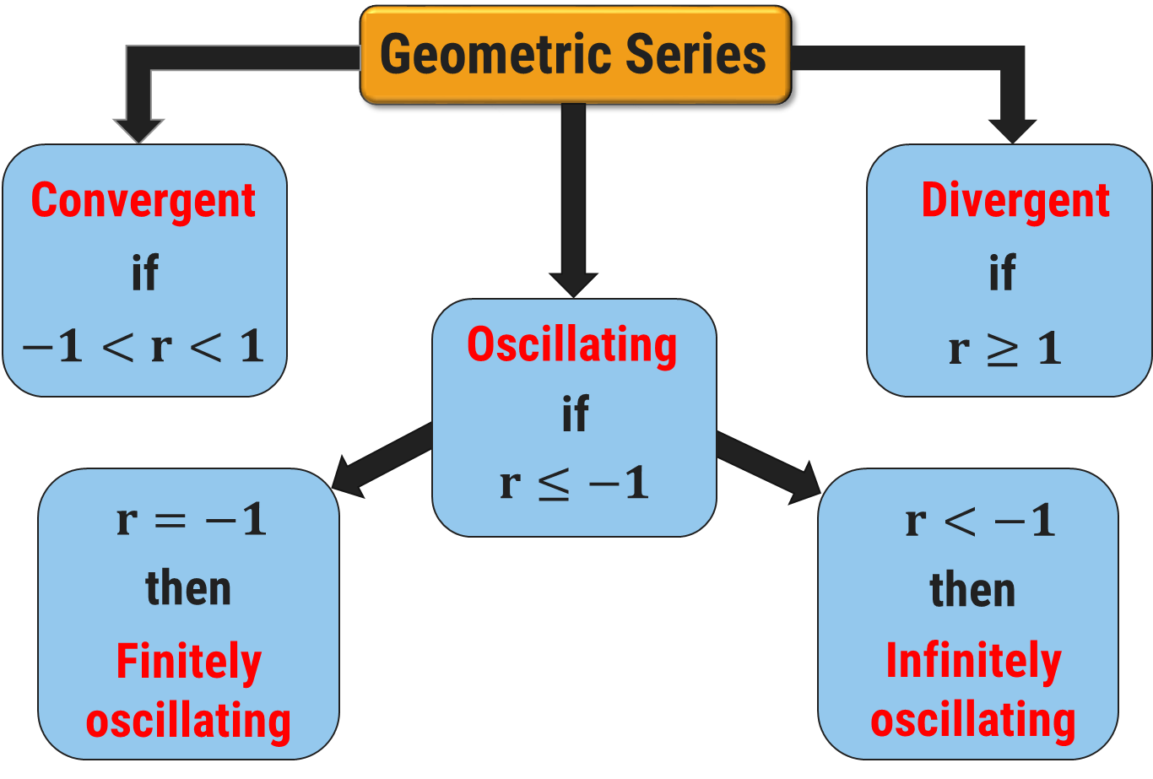
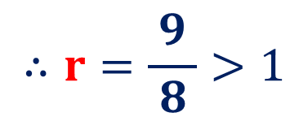
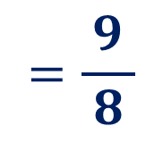
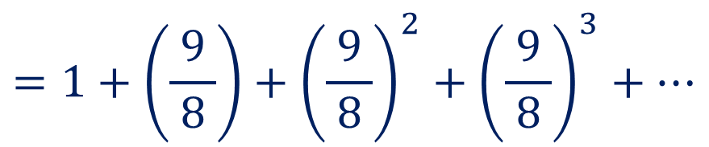

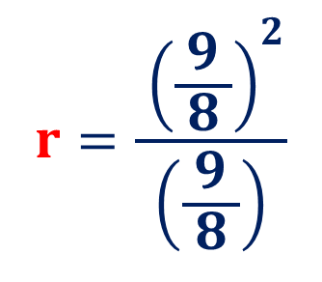
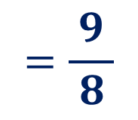
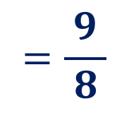
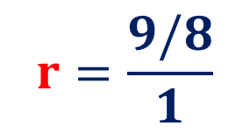
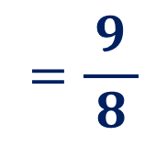


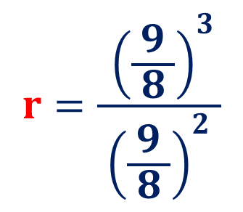
Method:4$⇝$ Example:1(Continue)
$$=1+\left(\frac{9}{ 8 }\right)+{\left(\frac{9}{ 8 }\right)}^{2}+{\left(\frac{9}{ 8 }\right)}^{3}+…$$
which is a geometric series,
$$r=\frac{9/8}{1}$$
$$=\frac{9}{ 8 }$$
$$r=\frac{9/8}{1}$$
$$=\frac{9}{ 8 }$$
where, $a=1$ and
$$>1$$
$$r=\frac{ {\left(\frac{9}{ 8 }\right)}^{2}}{\left(\frac{9}{ 8 }\right)}$$
$$∴r=\frac{9}{ 8 }>1$$
$$=\frac{9}{ 8 }$$
Thus, the given series is divergent.
$$r=\frac{ {\left(\frac{9}{ 8 }\right)}^{3}}{{ \left(\frac{9}{ 8 }\right)}^{2} }$$
$$=\frac{9}{ 8 }$$

Slide 14
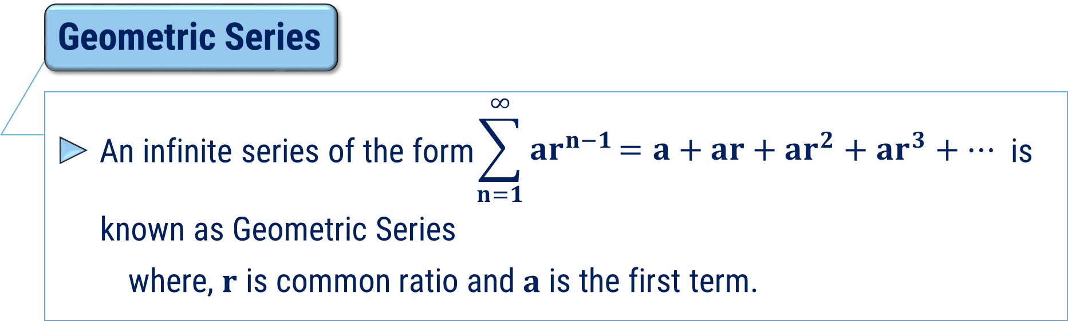
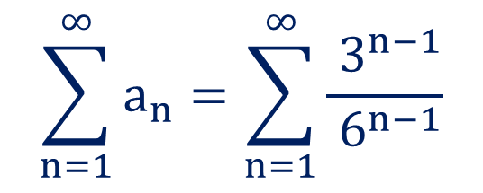
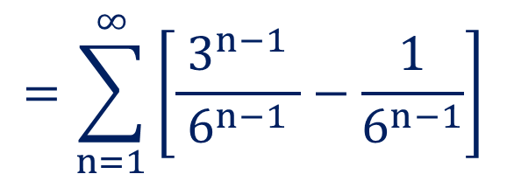
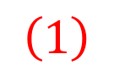
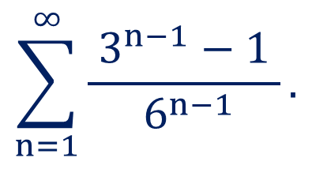
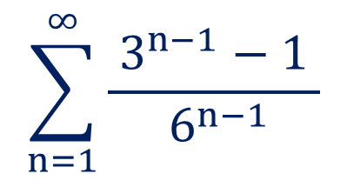
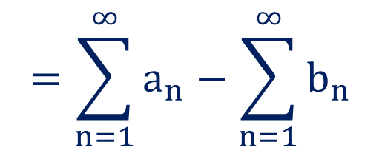
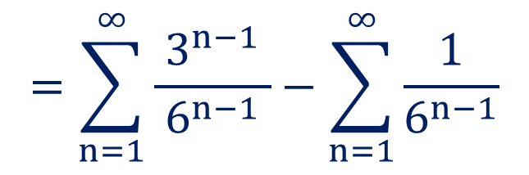
Method:4 Geometric Series
$$\sum_{n=1}^{∞}{\frac{ 3^{n−1}−1 }{ 6^{n−1}}}.$$
Example:2
Define the geometric series and find the sum of
$$\sum_{n=1}^{∞}{\frac{ 3^{n−1}−1 }{ 6^{n−1}}}$$
$$=\sum_{n=1}^{∞}{a_{n}}−\sum_{n=1}^{∞}{b_{n}}$$
Solution:
Here,
$$\left(1\right)$$
$$=\sum_{n=1}^{∞}{\left[\frac{3^{n−1}}{ 6^{n−1} }−\frac{1}{6^{n−1}}\right]}$$
$$\sum_{n=1}^{∞}{a_{n}}=\sum_{n=1}^{∞}{\frac{ 3^{n−1}}{ 6^{n−1}}}$$
Now,
$$=\sum_{n=1}^{∞}{\frac{3^{n−1}}{ 6^{n−1} }}−\sum_{n=1}^{∞}{\frac{1}{6^{n−1}}}$$

Slide 15
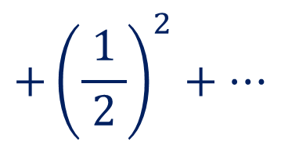
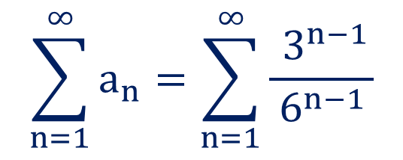
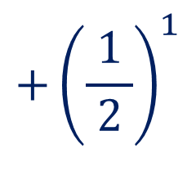
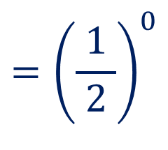
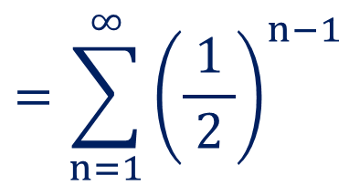
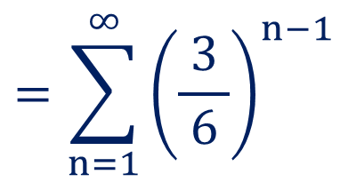
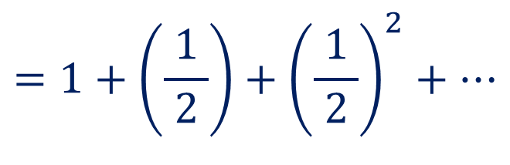
Method:4$⇝$Example:2(Continue)
$$\sum_{n=1}^{∞}{a_{n}}=\sum_{n=1}^{∞}{\frac{ 3^{n−1}}{ 6^{n−1 }}}$$
Now,
$$=\sum_{n=1}^{∞}{{\left(\frac{3}{ 6 }\right)}^{n−1}}$$
$$=\sum_{n=1}^{∞}{{\left(\frac{1}{ 2 }\right)}^{n−1}}$$
$$={\left(\frac{1}{ 2 }\right)}^{0}$$
$$+{\left(\frac{1}{ 2 }\right)}^{1}$$
$$+{\left(\frac{1}{ 2 }\right)}^{2}+…$$
$$=1+\left(\frac{1}{ 2 }\right)+{\left(\frac{1}{ 2 }\right)}^{2}+…$$

Slide 16
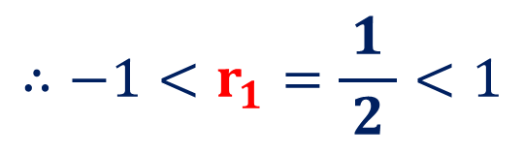
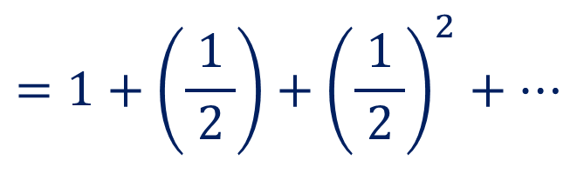

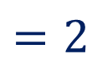
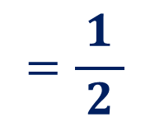
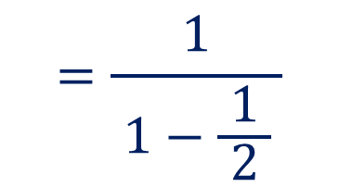




Method:4$⇝$Example:2(Continue)
$$=1+\left(\frac{1}{ 2 }\right)+{\left(\frac{1}{ 2 }\right)}^{2}+…$$
which is a geometric series,
$$r_{1}=\frac{1/2}{1}$$
$$=\frac{1}{ 2 }$$
where, $a_{1}=1$ and
$$<1$$
$$∴−1<r_{1}=\frac{1}{ 2 }<1$$
$$\sum_{n=1}^{∞}{a_{n}}$$
Thus, the series
is convergent and its sum is
$$S_{1}=\frac{a_{1}}{ 1−r_{1} }$$
$$=\frac{1}{ 1−\frac{1}{ 2 } }$$
$$=2$$

Slide 17








Method:4$⇝$ Example:2(Continue)
$$\sum_{n=1}^{∞}{b_{n}}=\sum_{n=1}^{∞}{\frac{ 1}{ 6^{n−1 }}}$$
Now,
$$=\sum_{n=1}^{∞}{{\left(\frac{1}{ 6 }\right)}^{n−1}}$$
$$=1+\left(\frac{1}{ 6 }\right)+{\left(\frac{1}{ 6 }\right)}^{2}+…$$
which is a geometric series,
$$r_{2}=\frac{1/6}{1}$$
$$=\frac{1}{ 6 }$$
where, $a_{2}=1$ and
$$<1$$
$$∴−1<r_{2}=\frac{1}{ 6 }<1$$

Slide 18







Method:4$⇝$ Example:2(Continue)
$$∴−1<r_{2}=\frac{1}{ 6 }<1$$
$$\sum_{n=1}^{∞}{b_{n}}$$
Thus, the series
is convergent and its sum is
$$S_{2}=\frac{a_{2}}{ 1−r_{2} }$$
$$=\frac{1}{ 1−\frac{1}{ 6 } }$$
$$=\frac{6}{ 5 }$$
Since, both the series are convergent, from equation (1)
$$\sum_{n=1}^{∞}{\frac{ 3^{n−1}−1 }{ 6^{n−1}}}$$
$$=\sum_{n=1}^{∞}{a_{n}}−\sum_{n=1}^{∞}{b_{n}}$$

Slide 19







Method:4$⇝$Example:2(Continue)
$$\sum_{n=1}^{∞}{\frac{ 3^{n−1}−1 }{ 6^{n−1}}}$$
$$=\sum_{n=1}^{∞}{a_{n}}−\sum_{n=1}^{∞}{b_{n}}$$
$$∴S=S_{1}−S_{2}$$
$$∴S=2−\frac{6}{ 5 }$$
$$=\frac{4}{ 5 }$$
$$\sum_{n=1}^{∞}{\frac{ 3^{n−1}−1 }{ 6^{n−1}}}$$
$$\frac{4}{ 5 }.$$
Thus, sum of the series
is

Slide 20








Method:4 Geometric Series
$$5−\frac{ 10 }{3}+\frac{ 20 }{9}−\frac{ 40 }{27}+…$$
Example:3
Test the convergence for
$$5−\frac{ 10 }{3}+\frac{ 20 }{9}−\frac{ 40 }{27}+…$$
Solution:
Here,
$$=5\left[1−\frac{2}{ 3 }+\frac{4}{ 9 }−\frac{8}{ 27 }+…\right]$$
$$=5\left[1−\frac{2}{ 3 }+{\left(\frac{2}{ 3 }\right)}^{2}−{\left(\frac{2}{ 3 }\right)}^{3}+…\right]$$
$$r=−\frac{2}{ 3 }$$
which is a geometric series,
where, $a=1$ and
$$<1$$
$$∴−1<r=−\frac{2}{ 3 }<1$$
Thus, the given series is convergent.

Slide 21














Method:4 Geometric Series
Example:4
The figure shows the first seven of a sequence of squares. The outermost square has an area of $4m^{2}$. Each of the other squares is obtained by joining the midpoints of the sides of the squares before it. Find the sum of areas of all squares in the infinite sequence.
$$1 m$$
$$1 m$$
$$A$$
$$H$$
$$G$$
$$1 m$$
$$B$$
$$F$$
$$1 m$$
$$C$$
$$D$$
$$E$$

Slide 22



Method:4$⇝$ Example:4(Continue)
Solution:
Since, each square is obtained by joining the midpoints of the square
before it, so the area of each square is half the area of previous square.
The area of second square
$$=\frac{1}{ 2 }×$$
$$=\frac{1}{ 2 }×4$$
area of outermost square
$=2$ $m^{2}$

Slide 23










Method:4$⇝$Example:4(Continue)
The area of second square
$$=\frac{1}{ 2 }×$$
$$=\frac{1}{ 2 }×4$$
area of outermost square
$$=2 m^{2}$$
The area of third square
$$=\frac{1}{ 2 }×$$
$$=\frac{1}{ 2 }×2$$
area of second square
$=1$ $m^{2}$
The area of fourth square
$$=\frac{1}{ 2 }×$$
$$=\frac{1}{ 2 }×1$$
$$=\frac{1}{ 2 }$$
area of third square
$$m^{2}$$
and so on…

Slide 24






Method:4 $⟹$Example:4(Continue)
Sum of areas of all squares in the infinite sequence is
$$S=4+2+1+\frac{1}{ 2 }+…$$
$$∴S=4\left[1+\frac{1}{ 2 }+{\left(\frac{1}{ 2 }\right)}^{2}+…\right]$$
which is a geometric series,
$$r=\frac{1}{ 2 }$$
where, $a=1$ and
$$<1$$
$$∴−1<r=\frac{1}{ 2 }<1$$

Slide 25





Method:4 $⟹$Example:4(Continue)
$$∴−1<r=\frac{1}{ 2 }<1$$
$$r∈\left(−1,1\right)$$
Thus, the given series is convergent and its sum is
$$∴S=4\left(\frac{a}{ 1−r }\right)$$
$$=4\left(\frac{1}{ 1−\frac{1}{ 2 } }\right)$$
$$=8$$
Sum of areas of all squares in the infinite sequence is $8 m^{2}.$

Slide 26
Method:5
Telescoping series

Slide 27
Infinite Series
Telescoping Series
A telescoping series is a series in which many terms cancel in the
partial sums.

Slide 28


















Remember this…
$$a_{n}=\frac{1}{\left(n+1\right)\left(n+2\right)}$$
$$=\frac{A}{ n+1 }+\frac{B}{ n+2 }$$
$$\frac{A}{ n+1 }$$
$$\frac{B}{ n+2 }$$
Partial Fraction:
$$\left(n+1\right)=0$$
$$⟹n=−1$$
$${∴a}_{n}=\frac{1}{\left(n+1\right)\left(n+2\right)}$$
$$\frac{1}{ \left(n+2\right) }$$
$$=\frac{1}{ \left(−1+2\right) }$$
$$∴A=$$
$$=1$$
$$=\frac{1}{ n+1 }−\frac{1}{ n+2 }$$
$$\left(n+2\right)=0$$
$$⟹n=−2$$
$$\frac{1}{ \left(n+1\right) }$$
$$=\frac{1}{ \left(−2+1\right) }$$
$$∴B=$$
$$=−1$$

Slide 29










Method:5 Telescoping Series
$$\frac{1}{ 1∙3 }+\frac{1}{ 3∙5 }+\frac{1}{ 5∙7 }+…$$
Example:1
Check the convergence of
$$\sum_{n=1}^{∞}{\frac{1}{ \left(2n−1\right)∙\left(2n+1\right) }}$$
$$\frac{1}{ 1∙3 }+\frac{1}{ 3∙5 }+\frac{1}{ 5∙7 }+…=$$
Solution:
$$\frac{1}{ \left(2n−1\right)∙\left(2n+1\right) }$$
$$=\frac{A}{ \left(2n−1\right) }+\frac{B}{ \left(2n+1\right) }$$
and
$$=\frac{1}{ 2 }\left[\frac{1}{ \left(2n−1\right) }−\frac{1}{ \left(2n+1\right) }\right]$$
$$\frac{1}{ 1∙3 }+\frac{1}{ 3∙5 }+\frac{1}{ 5∙7 }+…=\sum_{n=1}^{∞}{\frac{1}{ 2 }\left[\frac{1}{ \left(2n−1\right) }−\frac{1}{ \left(2n+1\right) }\right]}$$
$$\frac{1}{ \left(2n−1\right)∙\left(2n+1\right) }$$
$$:\frac{ \left(2n+1\right)−\left(2n−1\right) }{ \left(2n−1\right)∙\left(2n+1\right) }$$
$$=\frac{ 2}{ \left(2n−1\right)∙\left(2n+1\right) }$$

Slide 30




Method:5 $⟹$Example:1(Continue)
$$\frac{1}{ 1∙3 }+\frac{1}{ 3∙5 }+\frac{1}{ 5∙7 }+…=\sum_{n=1}^{∞}{\frac{1}{ 2 }\left[\frac{1}{ \left(2n−1\right) }−\frac{1}{ \left(2n+1\right) }\right]}$$
$$\sum_{n=1}^{m}{\frac{1}{ 2 }\left[\frac{1}{ \left(2n−1\right) }−\frac{1}{ \left(2n+1\right) }\right]}$$
Consider, $S_{m}=$
$$∴S_{m}=\frac{1}{ 2 }\left[\begin{aligned}\left(1−\frac{1}{ 3 }\right)+\left(\frac{1}{ 3 }−\frac{1}{ 5 }\right)+\left(\frac{1}{ 5 }−\frac{1}{ 7 }\right)+…+ \\ \left(\frac{1}{ 2m−3 }−\frac{1}{ 2m−1 }\right)+\left(\frac{1}{ 2m−1 }−\frac{1}{ 2m+1 }\right)\end{aligned}\right]$$

Slide 31







Method:5 $⟹$Example:1(Continue)
$$∴S_{m}=\frac{1}{ 2 }\left[\begin{aligned}\left(1−\frac{1}{ 3 }\right)+\left(\frac{1}{ 3 }−\frac{1}{ 5 }\right)+\left(\frac{1}{ 5 }−\frac{1}{ 7 }\right)+…+ \\ \left(\frac{1}{ 2m−3 }−\frac{1}{ 2m−1 }\right)+\left(\frac{1}{ 2m−1 }−\frac{1}{ 2m+1 }\right)\end{aligned}\right]$$
$$∴S_{m}=\frac{1}{ 2 }\left(1−\frac{1}{ 2m+1 }\right)$$
$$\frac{1}{ 2 }∙\lim_{m → ∞}\left(1−\frac{1}{ 2m+1 }\right)$$
$$=\frac{1}{ 2 }$$
$$\lim_{m → ∞}\left(\frac{1}{ m }\right)=0$$
Now,
$$\lim_{m → ∞}{S_{m}=}$$
which is finite.
$$\frac{1}{ 2 }.$$
Thus, the given series is convergent and its sum is

Slide 32
Method:6
Zero Test

Slide 33


Infinite Series
Zero Test or Cauchy’s Fundamental Test
$$\sum{u_{n}}$$
Suppose
is given series, where $u_{n}$ is the $n^{th}$ term of the series.
If
$$\lim_{n → ∞}{u_{n}}≠0$$
or does not exist,
then the given series is divergent.

Slide 34






Method:6 Zero Test
$$1).\sum_{n=1}^{∞}{\frac{n}{ 2n+5 }}$$
Example:1
Check the convergence of
$$\lim_{n → ∞}{\frac{n}{ 2n+5 }}$$
Solution:
Thus, by Zero Test,
the given series is divergent.
$$=\lim_{n → ∞}{\frac{n}{ n\left(2+\frac{5}{ n }\right) }}$$
$$=\frac{1}{ 2 }$$
$$\left\{∴\lim_{n→ ∞}\left(\frac{1}{ n }\right)=0\right\}$$
$$≠0$$

Slide 35






Method:6 Zero Test
$$2).\sum_{n=1}^{∞}{{\left(1+\frac{1}{ n }\right)}^{n}}$$
Example:1
Check the convergence of
$$\lim_{n → ∞}{{\left(1+\frac{1}{ n }\right)}^{n}}$$
Solution:
$${\left(1\right)}^{∞}$$
$$\lim_{n → ∞}{{\left(1+\frac{x}{ n }\right)}^{n}}=e^{x}$$
We know that
$$∴\lim_{n → ∞}{{\left(1+\frac{1}{ n }\right)}^{n}}=$$
$$e≈2.71≠0$$
Thus, by Zero Test, the given series is divergent.

Slide 36









Method:6 Zero Test
$$\frac{1}{ \sqrt{2} }+\frac{2}{ \sqrt{5} }+\frac{4}{ \sqrt{17} }+\frac{8}{ \sqrt{65} }+…$$
Example:3
Check the convergence of
$$\frac{1}{ \sqrt{2 } }+\frac{2}{ \sqrt{5 } }+\frac{4}{ \sqrt{17 } }+\frac{8}{ \sqrt{65 } }+…$$
$$=\sum_{n=0}^{∞}{\frac{ }{ }}$$
$$2^{n}$$
Solution:
$$\sqrt{4^{n}+1 }$$
$$u_{n}=\frac{2^{n}}{ \sqrt{4^{n}+1 } }$$
$$=\lim_{n → ∞}{\frac{2^{n}}{\sqrt{4^{n} }\sqrt{1+\frac{1}{{ 4}^{n} } } }}$$
Here,
$$\lim_{n → ∞}{\frac{2^{n}}{ \sqrt{4^{n}+1 } }}$$
Now,
$$=\lim_{n → ∞}{\frac{2^{n}}{{\left\{{\left(2\right)}^{2n}\right\}}^{\frac{1}{ 2 }}\sqrt{1+\frac{1}{{ 4}^{n} } } }}$$

Slide 37





Method:6 $⟹$Example:3(Continue)
$$=\lim_{n → ∞}{\frac{2^{n}}{{\left\{{\left(2\right)}^{2n}\right\}}^{\frac{1}{ 2 }}\sqrt{1+\frac{1}{{ 4}^{n} } } }}$$
Thus, by Zero Test, the given
series is divergent.
$$=\lim_{n → ∞}{\frac{2^{n}}{2^{n}\sqrt{1+\frac{1}{{ 4}^{n} } } }}$$
$$\left\{∴\lim_{n→ ∞}\left(\frac{1}{ n }\right)=0\right\}$$
$$=1$$
$$≠0$$

Slide 38












Note
$$\sum_{n=1}^{∞}{{\left(\frac{1}{ 2 }\right)}^{n−1}}$$
$$=1+\left(\frac{1}{ 2 }\right)+{\left(\frac{1}{ 2 }\right)}^{2}+…$$
$$\sum_{n=1}^{∞}{{\left(\frac{1}{ 6 }\right)}^{n−1}}$$
$$=1+\left(\frac{1}{ 6 }\right)+{\left(\frac{1}{ 6 }\right)}^{2}+…$$
$$\frac{5}{ 6 }$$
converges to$2$
converges to
$$\sum_{n=1}^{∞}{{\left(\frac{1}{ 2 }\right)}^{n−1}}−\sum_{n=1}^{∞}{{\left(\frac{1}{ 6 }\right)}^{n−1}}=$$
$$\left(1−1\right)+\left(\frac{1}{ 2 }−\frac{1}{ 6 }\right)+\left\{{\left(\frac{1}{ 2 }\right)}^{2}−{\left(\frac{1}{ 6 }\right)}^{2}\right\}+…$$
$$\frac{5}{ 6 }$$
$$=\frac{7}{ 6 }$$
converges to
$$2$$
$$−$$

Slide 39
Method:7
Combining Series

Slide 40

Method:7 Combining Series

Slide 41
Method:8
Integral Test

Slide 42




Method:8 Integral Test
Integral Test
$$\sum_{n=a}^{∞}{u_{n}}=\sum_{n=a}^{∞}{f\left(n\right)},$$
For the positive term series
if $f\left(n\right)$ is decreasing,
integrable and
$$1) \int_{a}^{∞}{f\left(x\right) dx}$$
is finite, then the given series is convergent.
$$2) \int_{a}^{∞}{f\left(x\right) dx}$$
is infinite, then the given series is divergent.

Slide 43









Method:8 Integral Test
$$\sum_{n=1}^{∞}{n∙e^{−n^{2}}}.$$
Example:1
Check the convergence of
$$\sum_{n=1}^{∞}{n∙e^{−n^{2}}}=\sum_{n=1}^{∞}{f\left(n\right)}$$
Solution:
Let,
Here, $f\left(n\right)=n∙e^{−n^{2}}$
$;n≥1$
Let$f\left(x\right)=x∙e^{−x^{2}}$
$;x≥1$
$∴f\left(x\right)=x∙e^{−x^{2}}$ is continuous and positive.
$$f\left(1\right)=\frac{1}{ e }≈0.37$$
Now, for $x=1,$

Slide 44









Method:8 $⟹$Example:1(Continue)
$$f\left(1\right)=\frac{1}{ e }≈0.37$$
Now, for $x=1,$
$$f\left(2\right)=\frac{2}{ e^{4} }≈0.04$$
for $x=2,$
$$f\left(3\right)=\frac{3}{ e^{9} }≈0.0004$$
for $x=3,$
and so on.
Thus, $f\left(x\right)$ is decreasing function.
Therefore, the integral test is applicable.
$$\int_{x=1}^{∞}{x∙e^{−x^{2}}}dx=$$
$$\lim_{m → ∞}{\int_{1}^{m}{x∙e^{−x^{2}}}dx}$$

Slide 45







Method:8 $⟹$Example:1(Continue)
$$\int_{x=1}^{∞}{x∙e^{−x^{2}}}dx=$$
$$\lim_{m → ∞}{\int_{1}^{m}{x∙e^{−x^{2}}}dx}$$
$$=\lim_{m → ∞}\left\{−\frac{1}{ 2 }\left(\int_{1}^{m}{\left(−2x\right)∙e^{−x^{2}}}dx\right)\right\}$$
$$=\lim_{m → ∞}\left\{−\frac{1}{ 2 }{\left(e^{−x^{2}}\right)}_{1}^{m}\right\}$$
$$=−\frac{1}{ 2 }\left\{\lim_{m → ∞}\left(e^{−m^{2}}−e^{−1}\right) \right\}$$
$$\int{e^{f\left(x\right)}}f^{′}\left(x\right) dx=$$
$$e^{f\left(x\right)}+c$$

Slide 46





Method:8 $⟹$Example:1(Continue)
$$=−\frac{1}{ 2 }\left\{\lim_{m → ∞}\left(e^{−m^{2}}−e^{−1}\right) \right\}$$
$$=−\frac{1}{ 2 }\left\{\lim_{m → ∞}\left(\frac{1}{ e^{m^{2} }}−\frac{1}{ e^{1} }\right) \right\}$$
$$=−\frac{1}{ 2 }\left\{\left(0−\frac{1}{ e }\right)\right\}$$
$$=\frac{1}{ 2e }$$
which is finite.
$$\lim_{x → ∞}{e^{x}}=∞$$
Thus, by integral test, the given series is convergent.

Slide 47







Method:8 Integral Test
$$\sum_{n=1}^{∞}{\frac{ 2∙\tan^{−1}{n }}{1+n^{2}}}.$$
Example:2
Test the convergence of
$$\sum_{n=1}^{∞}{\frac{ 2∙\tan^{−1}{n }}{1+n^{2}}}=\sum_{n=1}^{∞}{f\left(n\right)}$$
Solution:
Let,
$$f\left(n\right)=\frac{ 2∙\tan^{−1}{n }}{1+n^{2}}$$
Here,
$;n≥1$
$$f\left(x\right)=\frac{ 2∙\tan^{−1}{x }}{1+x^{2}}$$
Let,
$;x≥1$
$∴f\left(x\right)$ is continuous and positive.

Slide 48










Method:8 $⟹$Example:2(Continue)
$$f\left(1\right)=\frac{ 2∙\tan^{−1}\left(1\right) }{ 2 }≈$$
Now, for $x=1,$
$$0.78$$
$$f\left(2\right)=\frac{ 2∙\tan^{−1}\left(2\right) }{1+{\left(2\right)}^{2} }≈$$
For $x=2,$
$$0.44$$
$$f\left(3\right)=\frac{ 2∙\tan^{−1}\left(3\right) }{1+{\left(3\right)}^{2} }≈$$
For $x=3,$
$$0.25$$
and so on.
$$f\left(x\right)=\frac{ 2∙\tan^{−1}\left(x\right) }{1+{\left(x\right)}^{2} };x≥1$$
Thus,
is decreasing function.
Therefore, the integral test is applicable.

Slide 49










Method:8 $⟹$Example:2(Continue)
$$\int_{x=1}^{∞}{f\left(x\right)}dx$$
$$=\int_{x=1}^{∞}{\frac{ 2∙\tan^{−1}\left(x\right) }{1+x^{2}}}dx$$
$$f\left(x\right)=tan^{−1}\left(x\right)$$
Now,
$$f^{′}\left(x\right)=\frac{1}{ 1+x^{2} }$$
$$n=1$$
$$=\lim_{m → ∞}{\int_{1}^{m}{\frac{ 2∙\tan^{−1}\left(x\right) }{1+x^{2}}}dx}$$
$$=\lim_{m → ∞}{2{\left\{\frac{{ \left[\tan^{−1}\left(x\right)\right]}^{1+1} }{1+1}\right\}}_{1}^{m}}$$
$$\frac{ {\left[ f\left(x\right) \right]}^{n+1} }{n+1}+c;n > −1$$
$$\int{{\left[ f\left(x\right) \right]}^{n}}f^{′}\left(x\right) dx=$$
$$=\lim_{m → ∞}{2{\left\{\frac{{ \left[\tan^{−1}\left(x\right)\right]}^{2} }{2}\right\}}_{1}^{m}}$$

Slide 50







Method:8 $⟹$Example:2(Continue)
$$=\lim_{m → ∞}{2{\left\{\frac{{ \left[\tan^{−1}\left(x\right)\right]}^{2} }{2}\right\}}_{1}^{m}}$$
$$={{\left(\frac{π}{ 2 }\right)}^{2}−\frac{ π^{2} }{16}}$$
$$={\frac{ π^{2}}{4}−\frac{ π^{2}}{16}}$$
$$=\lim_{m → ∞}\left\{{\left[\tan^{−1}\left(m\right)\right]}^{2}−{\left[\tan^{−1}\left(1\right)\right]}^{2}\right\}$$
$$=\lim_{m → ∞}\left\{{\left[\tan^{−1}\left(m\right)\right]}^{2}−{\left[\frac{π}{ 4 }\right]}^{2}\right\}$$
$$={\frac{ 3π^{2}}{16}}$$
which is finite.
$$=\lim_{m → ∞}\left\{{\left[\tan^{−1}\left(m\right)\right]}^{2}\right\}−\frac{ π^{2} }{16}$$
Thus, by integral test,
the given series is convergent.

Slide 51








The p-series
$p$-series Test
$$\sum_{n=a}^{∞}{\frac{1}{{ n}^{p }}}$$
The series
is known as $p$-series.
$$\sum_{n=1}^{∞}{\frac{1}{{ n}^{p} }}$$
$$\sum_{n=1}^{∞}{\frac{1}{{ n}^{\frac{3}{ 2 } }}}$$
$$\sum_{n=1}^{∞}{\frac{1}{ n }}$$
Convergent
Divergent
if
if
$$p>1$$
$$p≤1$$

Slide 52
Method:9
Direct Comparison Test

Slide 53






Method:9 Direct Comparison Test
Direct Comparison Test
$$\sum{u_{n}}\&\sum{v_{n}}$$
If two given positive term series
with $0≤u_{n}≤v_{n}, ∀ n∈ ℕ$
and if
$$1)\sum{v_{n}}$$
$$\sum{u_{n}}$$
is convergent, then
is convergent.
$$2)\sum{u_{n}}$$
$$\sum{v_{n}}$$
is divergent, then
is divergent.

Slide 54












Method:9 Direct Comparison Test
$$\left(i\right).\sum_{n=1}^{∞}{\frac{1}{ \sqrt{n^{3}+1 } }}.$$
Example:1
Test the convergence of
$$\frac{1}{ 5 }=$$
$$u_{n}=\frac{1}{ \sqrt{n^{3}+1 } }$$
$$0.2$$
Solution:
Here,
$$\frac{1}{ 2 }=$$
$$0.5$$
$$v_{n}=\frac{1}{ \sqrt{n^{3 }} }$$
Let,
$$∴\frac{1}{ 5 }<\frac{1}{ 2 }$$
$$∴\frac{1}{ \sqrt{n^{3}+1 } }$$
$$\frac{1}{ \sqrt{n^{3}} }$$
$$≤$$
$$;∀ n≥1$$

Slide 55












Method:9 $⇝$Example:1(Continue)
$$∴\frac{1}{ \sqrt{n^{3}+1 } }$$
$$\frac{1}{ \sqrt{n^{3} } }$$
$$≤$$
$$;∀ n≥1$$
If bigger series is convergent, then smaller series is convergent.
$$∴u_{n}≤v_{n}$$
$$;∀ n≥1$$
$$\sum_{n=1}^{∞}{v_{n}=}$$
$$\sum_{n=1}^{∞}{\frac{1}{ \sqrt{n^{3}} }}$$
Also,
$$=\sum_{n=1}^{∞}{\frac{1}{ n^{\frac{3}{ 2 }} }}$$
$$p=\frac{3}{ 2 }$$
which is a $p$-series with
$$>1$$

Slide 56










Method:9 $⇝$Example:1(i) (Continue)
$$\sum_{n=1}^{∞}{v_{n}}$$
$$=\sum_{n=1}^{∞}{\frac{1}{ n^{\frac{3}{ 2 }} }}$$
$$p=\frac{3}{ 2 }$$
which is a $p$-series with
$$>1$$
$$\sum_{n=1}^{∞}{\frac{1}{ \sqrt{n^{3}} }}$$
So, by $p$-series test,
is convergent.
$$u_{n}≤v_{n}$$
$$;∀ n≥1$$
$$\sum_{n=1}^{∞}{\frac{1}{ \sqrt{n^{3}+1} }}$$
Thus, by direct comparison test,
is convergent.

Slide 57







Method:9 Direct Comparison Test
$$\left(ii\right).\sum_{n=1}^{∞}{\frac{1}{ 2\sqrt{n}−1 }}.$$
Example:1
Test the convergence of
$$u_{n}=\frac{1}{ 2\sqrt{n}−1 }$$
Solution:
Here,
If smaller series is divergent, then bigger series is divergent.
$$v_{n}=\frac{1}{ 2\sqrt{n} }$$
Let,
$$\frac{1}{ 2\sqrt{n}−1 }$$
$$\frac{1}{ 2\sqrt{n} }$$
$$≥$$
$$;∀ n≥1$$

Slide 58












Method:9 $⇝$Example:1(ii) (Continue)
$$\frac{1}{ 2\sqrt{n}−1 }$$
$$\frac{1}{ 2\sqrt{n} }$$
$$≥$$
$$;∀ n≥1$$
$$\sum_{n=1}^{∞}{v_{n}=}$$
$$\sum_{n=1}^{∞}{\frac{1}{ 2\sqrt{n} }}$$
Also,
$$=\frac{1}{ 2 }\sum_{n=1}^{∞}{\frac{1}{ n^{\frac{1}{ 2 }} }}$$
$$\left(1\right)$$
$$\sum_{n=1}^{∞}{\frac{1}{ n^{\frac{1}{ 2 }} }}$$
$$p=\frac{1}{ 2 }$$
Now,
is a $p$-series with
$$<1$$

Slide 59





Method:9 $⇝$Example:1(ii) (Continue)
$$\sum_{n=1}^{∞}{\frac{1}{ n^{\frac{1}{ 2 }} }}$$
So, by $p$-series test,
is divergent.
$$\frac{1}{ 2 }\sum_{n=1}^{∞}{\frac{1}{ n^{\frac{1}{ 2 }} }}$$
From equation $\left(1\right)$, the series
is divergent.
($∵$ if $\sum{a_{n}}$ is diverges, then $\sum{{k∙a}_{n}}$ is also diverges.)
$$\sum_{n=1}^{∞}{\frac{1}{ n^{\frac{1}{ 2 }} }}$$
$$p=\frac{1}{ 2 }$$
$$\sum_{n=1}^{∞}{\frac{1}{ 2\sqrt{n}−1 }}$$
Now,
is a $p$-series with
$$<1$$
Thus, by direct comparison test,
is divergent.

Slide 60







Method:9 Direct Comparison Test
$$\left(iii\right).\sum_{n=1}^{∞}{\frac{1}{ 3^{n}+1 }}.$$
Example:1
Test the convergence of
$$u_{n}=\frac{1}{ 3^{n}+1 }$$
Solution:
Here,
$$v_{n}=\frac{1}{ 3^{n} }$$
If bigger series is convergent, then smaller series is convergent.
Let,
$$∴\frac{1}{ 3^{n}+1 }$$
$$\frac{1}{ 3^{n} }$$
$$≤$$
$$;∀ n≥1$$

Slide 61











Method:9 $⇝$Example:1(iii) (Continue)
$$∴\frac{1}{ 3^{n}+1 }$$
$$\frac{1}{ 3^{n} }$$
$$≤$$
$$;∀ n≥1$$
$$\sum_{n=1}^{∞}{\frac{1}{ 3^{n} }}$$
$$=\sum_{n=1}^{∞}{{\left(\frac{1}{ 3 }\right)}^{n}}$$
Now,
$$=\left(\frac{1}{ 3 }\right)+{\left(\frac{1}{ 3 }\right)}^{2}+{\left(\frac{1}{ 3 }\right)}^{3}…$$
which is a geometric series,
$$r=\frac{{ \left(\frac{1}{ 3 }\right)}^{2}}{\frac{1}{ 3 }}$$
where, $a=\frac{1}{ 3 }$ and
$$=\frac{1}{ 3 }$$
$$<1$$

Slide 62







Method:9 $⇝$Example:1(iii) (Continue)
$$r=\frac{{ \left(\frac{1}{ 3 }\right)}^{2}}{\frac{1}{ 3 }}$$
where, $a=\frac{1}{ 3 }$ and
$$=\frac{1}{ 3 }$$
$$<1$$
$$∴−1<r=\frac{1}{ 3 }<1$$
$$∴\sum_{n=1}^{∞}{\frac{1}{ 3^{n} }}$$
is convergent.
$$\sum_{n=1}^{∞}{\frac{1}{ 3^{n}+1 }}$$
Thus, by direct comparison test,
is convergent.

Slide 63





Remember this…
$$\sum_{n=1}^{∞}{\frac{ log n }{{ n}^{p} }}$$
$$p≤1$$
$$p>1$$
$$\frac{1}{ n^{p} }≤\frac{log n}{n^{p}}$$
$$\frac{log n}{n^{p}}≤\frac{1}{n^{\left(\frac{ p+1 }{2}\right)}}$$

Slide 64











Method:9 Direct Comparison Test
$$\left(i\right).\sum_{n=1}^{∞}{\frac{ log n }{n}}.$$
Example:2
Check the convergence of
$$u_{n}=\frac{ log n }{ n}$$
Solution:
Here,
We know that, for $p≤1$
$$\frac{1}{ n^{p }}≤\frac{ log n }{ n^{p}}.$$
Here,
$$p=1$$
$$∴\frac{1}{ n }$$
$$\frac{ log n }{ n}$$
$$v_{n}=\frac{1}{ n }$$
$$≤$$
$$;∀ n≥1$$
where,

Slide 65











Method:9 $⇝$Example:2(i) (Continue)
$$∴\frac{1}{ n }$$
$$\frac{ log n }{ n}$$
$$v_{n}=\frac{1}{ n }$$
$$≤$$
$$;∀ n≥1$$
where,
$$\sum_{n=1}^{∞}{v_{n}=}$$
$$\sum_{n=1}^{∞}{\frac{1}{ n }}$$
Also,
which is a $p$-series with
$$p=1$$
$$\sum_{n=1}^{∞}{\frac{1}{ n }}$$
So, by $p$-series test,
is divergent.
$$\sum_{n=1}^{∞}{\frac{ log n }{ n }}$$
Thus, by direct comparison test,
is divergent.

Slide 66








Method:9 Direct Comparison Test
$$\left(ii\right).\sum_{n=1}^{∞}{\frac{ log n }{n^{2}}}.$$
Example:2
Check the convergence of
$$u_{n}=\frac{ log n }{ n^{2}}$$
Solution:
Here,
We know that, for $p>1$
$$\frac{ log n }{ n^{p }}≤\frac{ 1}{ n^{\left(\frac{ p+1 }{2}\right) }}.$$
Here, $p=2$
$$∴\frac{ log n }{ n^{2 }}≤\frac{ 1}{ n^{\frac{3}{ 2 } }}$$
$$v_{n}=\frac{1}{ n^{\frac{3}{ 2 }} }$$
$$;∀ n≥1$$
where,

Slide 67











Method:9 $⇝$Example:2(ii) (Continue)
$$∴\frac{ log n }{ n^{2 }}≤\frac{ 1}{ n^{\frac{3}{ 2 } }}$$
$$v_{n}=\frac{1}{ n^{\frac{3}{ 2 }} }$$
$$;∀ n≥1,$$
where,
$$\sum_{n=1}^{∞}{v_{n}=}$$
$$\sum_{n=1}^{∞}{\frac{1}{ n^{\frac{3}{ 2 }} }}$$
$$p=\frac{3}{ 2 }$$
Also,
which is a $p$-series with
$$>1$$
$$\sum_{n=1}^{∞}{\frac{1}{ n^{\frac{3}{ 2 }} }}$$
So, by $p$-series test,
is convergent.
$$\sum_{n=1}^{∞}{\frac{ log n }{ n^{2} }}$$
Thus, by direct comparison test,
is convergent.

Slide 68
Method:10
Limit Comparison Test

Slide 69





Method:10 Limit Comparison Test
Limit Comparison Test
$$\sum{u_{n}}\left(given\right) \&\sum{v_{n}}(choose)$$
If two positive term series
be such that
$$\lim_{n → ∞}{\frac{u_{n}}{{ v}_{n} }}=L$$
and
$$1)$$
If $L$ is finite and non-zero, then both series $\sum{u_{n}}\&\sum{v_{n}}$ are
convergent or divergent together.
$$2)$$
If $L=0$ and if $\sum{v_{n}}$ is convergent, then $\sum{u_{n}}$ is convergent.
$$3)$$
If $L=∞$ and if $\sum{v_{n}}$ is divergent, then $\sum{u_{n}}$ is divergent.

Slide 70








Method:10 Limit Comparison Test
$$\sum_{n=1}^{∞}{\frac{ 3n^{2}+5n }{ 7+n^{4}}}.$$
Example:1
Check the convergence of
$$u_{n}=\frac{ 3n^{2}+5n }{ 7+n^{4}}$$
Solution:
Here,
$$n^{2}$$
$$=\frac{1}{{ n}^{2} }$$
Let,
$$v_{n}=\frac{ }{ }$$
$$n^{4}$$
$$\lim_{n → ∞}{\frac{u_{n}}{ v_{n} }}=$$
$$\lim_{n → ∞}{\frac{ \left(3n^{2}+5n\right)∙n^{2}}{7+n^{4}}}$$
Now,

Slide 71






Method:10 $⇝$Example:1(Continue)
$$\lim_{n → ∞}{\frac{u_{n}}{ v_{n} }}=$$
$$\lim_{n → ∞}{\frac{ n^{2}∙\left(3n^{2}+5n\right) }{7+n^{4}}}$$
Now,
$$=\lim_{n → ∞}{\frac{ n^{2}∙n^{2}\left(3+\frac{ 5n }{n^{2}}\right) }{n^{4}\left(\frac{7}{{ n}^{4} }+1\right)}}$$
$$=\frac{ \left(3+0\right) }{\left(0+1\right)}$$
$$=3$$
$$=\lim_{n → ∞}{\frac{ \left(3+\frac{ 5 }{n}\right) }{\left(\frac{7}{{ n}^{4} }+1\right)}}$$
which is finite and non-zero

Slide 72










Method:10 $⇝$Example:1(Continue)
$$=3$$
which is finite and non-zero
Therefore, both the series are convergent or divergent together.
$$\sum_{n=1}^{∞}{v_{n}}=$$
$$\sum_{n=1}^{∞}{\frac{1}{{ n}^{2} }}$$
Now,
which is a $p$-series with
$$p=2$$
$$>1$$
$$\sum_{n=1}^{∞}{\frac{1}{ n^{2} }}$$
So, by $p$-series test,
is convergent.
$$\sum_{n=1}^{∞}{\frac{ 3n^{2}+5n }{ 7+n^{4}}}$$
Thus, by limit comparison test,
is convergent.

Slide 73





Method:10 Limit Comparison Test
$$\left(i\right).\sum_{n=1}^{∞}{\frac{ 1}{ 2^{n}−3 }}.$$
Example:2
Check the convergence of
$$u_{n}=\frac{ 1}{ 2^{n}−3 }$$
Solution:
Here,
$$\frac{1}{ 2^{n} }$$
Let,
$$v_{n}=$$
$$\lim_{n → ∞}{\frac{ \frac{ 1}{ 2^{n}−3 } }{\frac{1}{ 2^{n} }}}$$
$$\lim_{n → ∞}{\frac{u_{n}}{ v_{n} }}=$$
Now,

Slide 74








Method:10 $⇝$Example:2(i)(Continue)
$$\lim_{n → ∞}{\frac{ \frac{ 1}{ 2^{n}−3 } }{\frac{1}{ 2^{n} }}}$$
$$=\frac{1}{ \left(1−\frac{3}{{ 2}^{∞} }\right) }$$
$$\lim_{n → ∞}{\frac{u_{n}}{ v_{n} }}=$$
Now,
$$=\frac{1}{ \left(1−\frac{3}{ ∞ }\right) }$$
$$=\lim_{n → ∞}{\frac{2^{n}}{ 2^{n}−3 }}$$
$$=\lim_{n → ∞}{\frac{2^{n}}{ 2^{n}\left(1−\frac{3}{{ 2}^{n} }\right) }}$$
$$=\frac{1}{ \left(1−0\right) }$$
$$=1$$
which is finite and non-zero

Slide 75





Method:10 $⇝$Example:2(i)(Continue)
$$=1$$
which is finite and non-zero
Therefore, both the series are convergent or divergent together.
$$\sum_{n=1}^{∞}{v_{n}}=$$
$$\sum_{n=1}^{∞}{\frac{1}{{ 2}^{n} }}$$
Now,
$$=\sum_{n=1}^{∞}{{\left(\frac{1}{ 2 }\right)}^{n}}$$
$$=\left(\frac{1}{ 2 }\right)+{\left(\frac{1}{ 2 }\right)}^{2}+{\left(\frac{1}{ 2 }\right)}^{3}…$$

Slide 76








Method:10 $⇝$Example:2(i)(Continue)
$$=\left(\frac{1}{ 2 }\right)+{\left(\frac{1}{ 2 }\right)}^{2}+{\left(\frac{1}{ 2 }\right)}^{3}…$$
which is a geometric series,
$$r=\frac{{ \left(\frac{1}{ 2 }\right)}^{2}}{\frac{1}{ 2 }}$$
$$=\frac{1}{ 2 }$$
$$∴−1<r=\frac{1}{ 2 }<1$$
where, $a=\frac{1}{ 2 }$ and
$$<1$$
$$∴\sum_{n=1}^{∞}{\frac{1}{ 2^{n}}}$$
is convergent.
$$\sum_{n=1}^{∞}{\frac{1}{ 2^{n}−3 }}$$
Thus, by limit comparison test,
is convergent.

Slide 77





Method:10 Limit Comparison Test
$$\left(ii\right).\sum_{n=1}^{∞}{\frac{ 3+2∙\sin\left(n\right)}{ n^{3}}}.$$
Example:2
Check the convergence of
$$u_{n}=\frac{ 3+2∙\sin\left(n\right)}{ n^{3}}$$
Solution:
Here,
$$\frac{n}{ n^{3} }$$
$$=\frac{1}{ n^{2} }$$
Let,
$$v_{n}=$$
$$\lim_{n → ∞}{\frac{\frac{ 3+2∙\sin\left(n\right)}{ n^{3}} }{\frac{1}{ n^{2} }}}$$
$$\lim_{n → ∞}{\frac{u_{n}}{ v_{n} }}=$$
Now,

Slide 78








Method:10 $⇝$Example:2(ii)(Continue)
$$\lim_{n → ∞}{\frac{\frac{ 3+2∙\sin\left(n\right)}{ n^{3}} }{\frac{1}{ n^{2} }}}$$
$$\lim_{n → ∞}{\frac{u_{n}}{ v_{n} }}=$$
Now,
$$=\lim_{n → ∞}{\frac{ n^{2}∙\left\{3+2∙\sin\left(n\right)\right\} }{n^{3}}}$$
$$=0$$
$$\left\{∵\lim_{n → ∞}{\frac{ sin \left(n\right) }{ n }}=0\right\}$$
$$=\lim_{n → ∞}{\frac{ 3+2∙\sin\left(n\right) }{n}}$$
$$\& \left\{\lim_{n → ∞}{\frac{1}{ n }}=0\right\}$$
$$=\lim_{n → ∞}{\frac{3}{ n }}+2\lim_{n → ∞}{\frac{sin \left(n\right)}{ n }}$$

Slide 79









Method:10 $⇝$Example:2(ii)(Continue)
$$\left\{∵\lim_{n → ∞}{\frac{ sin \left(n\right) }{ n }}=0\right\}$$
$$\& \left\{\lim_{n → ∞}{\frac{1}{ n }}=0\right\}$$
$$=0$$
Thus, by the limit comparison test, if $\sum{v_{n}}$ is convergent, then $\sum{u_{n}}$ is convergent.
$$\sum_{n=1}^{∞}{v_{n}}=$$
$$\sum_{n=1}^{∞}{\frac{1}{{ n}^{2} }}$$
Now,
which is a $p$-series with
$$p=2$$
$$>1$$
$$\sum_{n=1}^{∞}{\frac{1}{ n^{2} }}$$
So, by $p$-series test,
is convergent.
$$\sum_{n=1}^{∞}{\frac{ 3+2∙\sin\left(n\right)}{ n^{3}}}$$
Thus, the given series
is convergent.

Slide 80




Method:10 Limit Comparison Test
$$\left(iii\right).\sum_{n=1}^{∞}{[{10}^{\frac{1}{ n }}−1]}.$$
Example:2
Check the convergence of
$$u_{n}={10}^{\frac{1}{ n }}−1$$
Solution:
Here,
$$\frac{1}{ n }$$
Let,
$$v_{n}=$$
$$\lim_{n → ∞}{\frac{ {10}^{\frac{1}{ n }}−1 }{\frac{1}{ n }}}$$
$$\lim_{n → ∞}{\frac{u_{n}}{ v_{n} }}=$$
Now,

Slide 81






Method:10 $⇝$Example:2(iii)(Continue)
$$\lim_{n → ∞}{\frac{ {10}^{\frac{1}{ n }}−1 }{\frac{1}{ n }}}$$
$$\lim_{n → ∞}{\frac{u_{n}}{ v_{n} }}=$$
$$=\frac{ {10}^{0}−1 }{0}$$
$$\left(\frac{0}{ 0 }\right)$$
Now,
Applying L’Hospital’s rule
$$=\lim_{n → ∞}{\frac{ {10}^{\frac{1}{ n }} log 10∙\left(−\frac{1}{n^{2}}\right) }{\left(−\frac{1}{n^{2}}\right)}}$$
$$=\lim_{n → ∞}{{10}^{\frac{1}{ n }} log 10}$$

Slide 82








Method:10 $⇝$Example:2(iii)(Continue)
$$=\lim_{n → ∞}{{10}^{\frac{1}{ n }} log 10}$$
$$\left\{∴\lim_{n→ ∞}\left(\frac{1}{ n }\right)=0\right\}$$
$$= log 10$$
which is finite and non-zero
Therefore, by limit comparison test both the series are convergent or divergent
together.
$$\sum_{n=1}^{∞}{v_{n}}=$$
$$\sum_{n=1}^{∞}{\frac{1}{ n }}$$
Now,
which is a $p$-series with
$$p=1$$
$$\sum_{n=1}^{∞}{\frac{1}{ n }}$$
So, by $p$-series test,
is divergent.

Slide 83



Method:10 $⇝$Example:2(iii)(Continue)
$$\sum_{n=1}^{∞}{\frac{1}{ n }}$$
So, by $p$-series test,
is divergent.
$$\sum_{n=1}^{∞}{[{10}^{\frac{1}{ n }}−1]}$$
Thus, by limit comparison test the given series
is divergent.

Slide 84





Method:10 Limit Comparison Test
$$\left(i\right).\sum_{n=1}^{∞}{\frac{ \sqrt{n+1}−\sqrt{n} }{n}}.$$
Example:3
Check the convergence of
$$u_{n}=\frac{ \sqrt{n+1}−\sqrt{n} }{n}$$
Solution:
Here,
$${∴u}_{n}=\frac{ \sqrt{n+1}−\sqrt{n} }{n}$$
$$∙\frac{ \sqrt{n+1}+\sqrt{n }}{\sqrt{n+1}+\sqrt{n}}$$
$${∴u}_{n}=\frac{ {\left(\sqrt{n+1}\right)}^{2}−{\left(\sqrt{n}\right)}^{2} }{n\left(\sqrt{n+1}+\sqrt{n}\right)}$$

Slide 85









Method:10 $⇝$Example:3(i)(Continue)
$${∴u}_{n}=\frac{ {\left(\sqrt{n+1}\right)}^{2}−{\left(\sqrt{n}\right)}^{2} }{n\left(\sqrt{n+1}+\sqrt{n}\right)}$$
$$\frac{1}{ n^{\frac{3}{ 2 }} }$$
Let,
$$v_{n}=$$
$${∴u}_{n}=\frac{n+1−n }{n\left(\sqrt{n+1}+\sqrt{n}\right)}$$
$$\lim_{n → ∞}{\frac{u_{n}}{ v_{n} }}$$
Now,
$$=\lim_{n → ∞}{\frac{n^{\frac{3}{ 2 }}}{ n^{\frac{3}{ 2 }}\left(\sqrt{1+\frac{1}{ n }}+1\right) }}$$
$${∴u}_{n}=\frac{1}{n∙\sqrt{n}\left(\sqrt{1+\frac{1}{ n }}+1\right)}$$
$${∴u}_{n}=\frac{1}{n^{\frac{3}{ 2 }}\left(\sqrt{1+\frac{1}{ n }}+1\right)}$$
$$=\frac{1}{ \left(\sqrt{1+0}+1\right) }$$

Slide 86








Method:10 $⇝$Example:3(i)(Continue)
$$=\frac{1}{ \left(\sqrt{1+0}+1\right) }$$
$$=\frac{1}{ 2 }$$
which is finite and non-zero
Therefore, by limit comparison test both the series are convergent or divergent
together.
$$\sum_{n=1}^{∞}{v_{n}}=$$
$$\sum_{n=1}^{∞}{\frac{1}{ n^{\frac{3}{ 2 } } }}$$
$$p=\frac{3}{ 2 }$$
Now,
which is a $p$-series with
$$>1$$
$$\sum_{n=1}^{∞}{\frac{1}{ n^{\frac{3}{ 2 } } }}$$
So, by $p$-series test,
is convergent.

Slide 87



Method:10 $⇝$Example:3(i)(Continue)
$$\sum_{n=1}^{∞}{\frac{1}{ n^{\frac{3}{ 2 } } }}$$
So, by $p$-series test,
is convergent.
$$\sum_{n=1}^{∞}{\frac{ \sqrt{n+1}−\sqrt{n} }{n}}$$
Thus, by limit comparison test the given series
is convergent.

Slide 88





Method:10 Limit Comparison Test
$$\left(ii\right).\sum_{n=1}^{∞}{\sqrt{n^{4}+1}}−\sqrt{n^{4}−1}.$$
Example:3
Check the convergence of
Solution:
$$u_{n}=\sqrt{n^{4}+1}−\sqrt{n^{4}−1}$$
Here,
$$∙\frac{ \sqrt{n^{4}+1}+\sqrt{n^{4}−1} }{\sqrt{n^{4}+1}+\sqrt{n^{4}−1}}$$
$${∴u}_{n}=\sqrt{n^{4}+1}−\sqrt{n^{4}−1}$$
$${∴u}_{n}=\frac{ {\left(\sqrt{n^{4}+1}\right)}^{2}−{\left(\sqrt{n^{4}−1}\right)}^{2} }{\left(\sqrt{n^{4}+1}+\sqrt{n^{4}−1}\right)}$$

Slide 89







Method:10 $⇝$Example:3(ii)(Continue)
$${∴u}_{n}=\frac{ {\left(\sqrt{n^{4}+1}\right)}^{2}−{\left(\sqrt{n^{4}−1}\right)}^{2} }{\left(\sqrt{n^{4}+1}+\sqrt{n^{4}−1}\right)}$$
$$\frac{1}{ n^{2} }$$
Let,
$$v_{n}=$$
$$\lim_{n → ∞}{\frac{u_{n}}{ v_{n} }}$$
$${∴u}_{n}=\frac{ n^{4}+1−n^{4}+1}{\left(\sqrt{n^{4}+1}+\sqrt{n^{4}−1}\right)}$$
Now,
$${∴u}_{n}=\frac{2}{ \sqrt{n^{4}}\left(\sqrt{1+\frac{1}{ n^{4} }}+\sqrt{1−\frac{1}{{ n}^{4} }}\right) }$$
Complete this example by yourself.
$${∴u}_{n}=\frac{2}{ n^{2}\left(\sqrt{1+\frac{1}{ n^{4} }}+\sqrt{1−\frac{1}{{ n}^{4} }}\right) }$$

Slide 90




Method:10 Limit Comparison Test
$$\left(i\right).\sum_{n=1}^{∞}{\tan\left(\frac{1}{ n }\right)}.$$
Example:4
Check the convergence of
$$u_{n}=\tan\left(\frac{1}{ n }\right)$$
Solution:
Here,
$$\frac{1}{ n }$$
Let,
$$v_{n}=$$
$$\lim_{n → ∞}{\frac{ \tan\left(\frac{1}{ n }\right) }{\frac{1}{ n }}}$$
$$\lim_{n → ∞}{\frac{u_{n}}{ v_{n} }}=$$
Now,

Slide 91





Method:10 $⇝$Example:4(i)(Continue)
$$\lim_{n → ∞}{\frac{ \tan\left(\frac{1}{ n }\right) }{\frac{1}{ n }}}$$
$$\lim_{n → ∞}{\frac{u_{n}}{ v_{n} }}=$$
Now,
$$=\lim_{\frac{1}{ n } → 0}{\frac{ \tan\left(\frac{1}{ n }\right) }{\frac{1}{ n }}}$$
$$\left(∵as n→∞,\frac{1}{ n }→0\right)$$
$$=1$$
which is finite and non-zero
Therefore, by limit comparison test both the series are convergent or divergent
together.

Slide 92






Method:10 $⇝$Example:4(i)(Continue)
$$\sum_{n=1}^{∞}{v_{n}}=$$
$$\sum_{n=1}^{∞}{\frac{1}{ n }}$$
Now,
which is a $p$-series with
$$p=1$$
$$\sum_{n=1}^{∞}{\frac{1}{ n }}$$
So, by $p$-series test,
is divergent.
$$\sum_{n=1}^{∞}{\tan\left(\frac{1}{ n }\right)}$$
Thus, by limit comparison test the given series
is divergent.

Slide 93




Method:10 Limit Comparison Test
$$\left(ii\right).\sum_{n=1}^{∞}{\frac{1}{ n }\sin\left(\frac{1}{ n }\right)}.$$
Example:4
Check the convergence of
$$u_{n}=\frac{1}{ n }\sin\left(\frac{1}{ n }\right)$$
Solution:
Here,
$$\frac{1}{ n^{2} }$$
Let,
$$v_{n}=$$
$$\lim_{n → ∞}{\frac{ \frac{1}{ n }\sin\left(\frac{1}{ n }\right) }{\frac{1}{ n^{2} }}}$$
$$\lim_{n → ∞}{\frac{u_{n}}{ v_{n} }}=$$
Now,

Slide 94





Method:10 $⇝$Example:4(ii)(Continue)
$$\lim_{n → ∞}{\frac{ \frac{1}{ n }\sin\left(\frac{1}{ n }\right) }{\frac{1}{ n^{2} }}}$$
$$\lim_{n → ∞}{\frac{u_{n}}{ v_{n} }}=$$
Now,
$$=\lim_{n → ∞}{\frac{ \sin\left(\frac{1}{ n }\right) }{\frac{1}{ n }}}$$
$$=\lim_{\frac{1}{ n } → 0}{\frac{ \sin\left(\frac{1}{ n }\right) }{\frac{1}{ n }}}$$
$$\left(∵as n→∞,\frac{1}{ n }→0\right)$$
$$=1$$
which is finite and non-zero

Slide 95









Method:10 $⇝$Example:4(i)(Continue)
$$=1$$
which is finite and non-zero
Therefore, by limit comparison test both the series are convergent or divergent
together.
$$\sum_{n=1}^{∞}{v_{n}}=$$
$$\sum_{n=1}^{∞}{\frac{1}{ n^{2} }}$$
Now,
which is a $p$-series with
$$p=2$$
$$>1$$
$$\sum_{n=1}^{∞}{\frac{1}{ n^{2} }}$$
So, by $p$-series test,
is convergent.
$$\sum_{n=1}^{∞}{\frac{1}{ n }\sin\left(\frac{1}{ n }\right)}$$
Thus, by limit comparison test the given series
is convergent.

Slide 96









Formulae…
$$\sum_{k=1}^{n}{k}$$
$$=\frac{ n\left(n+1\right) }{ 2}$$
$$1+2+3+4+5+…+n=$$
$$\sum_{k=1}^{n}{k^{2}}$$
$$=\frac{ n\left(n+1\right)\left(2n+1\right) }{ 6}$$
$$1^{2}+2^{2}+3^{2}+4^{2}+5^{2}+…+n^{2}=$$
$$\sum_{k=1}^{n}{k^{3}}$$
$$={\left[\frac{ n\left(n+1\right) }{2}\right]}^{2}$$
$$1^{3}+2^{3}+3^{3}+4^{3}+5^{3}+…+n^{3}=$$

Slide 97





Method:10 Limit Comparison Test
$$\sum_{n=1}^{∞}{\frac{1}{ 1^{2}+2^{2}+3^{2}+…+n^{2} }}.$$
Example:5
Test the convergence of
$$\sum_{n=1}^{∞}{\frac{1}{ 1^{2}+2^{2}+3^{2}+…+n^{2} }}.$$
$$\sum_{k=1}^{n}{k^{2}}$$
Solution:
Here,
$$=\sum_{n=1}^{∞}{\frac{1}{ }}$$
$$\sum_{k=1}^{n}{k^{2}}$$

Slide 98












Method:10 $⇝$Example:5(Continue)
$$=\sum_{n=1}^{∞}{\frac{1}{ }}$$
$$∴u_{n}=\frac{ 6}{ n^{3}\left(1+\frac{1}{ n }\right)\left(2+\frac{1}{ n }\right) }$$
$$\sum_{k=1}^{n}{k^{2}}$$
$$\frac{1}{ n^{3} }$$
Let,
$$v_{n}=$$
$$=\sum_{n=1}^{∞}{\frac{ 6}{ n\left(n+1\right)\left(2n+1\right) }}$$
$$∵\sum_{k=1}^{n}{k^{2}}=\frac{ n\left(n+1\right)\left(2n+1\right) }{ 6}$$
$$\lim_{n → ∞}{\frac{u_{n}}{ v_{n} }}$$
Now,
$$=\lim_{n → ∞}{\frac{6∙n^{3}}{ n^{3}\left(1+\frac{1}{ n }\right)\left(2+\frac{1}{ n }\right) }}$$
$$u_{n}=\frac{ 6}{ n\left(n+1\right)\left(2n+1\right) }$$
$$n∙$$
$$n∙$$
$$n$$
Here,

Slide 99




Method:10 $⇝$Example:5(Continue)
$$=\lim_{n → ∞}{\frac{6∙n^{3}}{ n^{3}\left(1+\frac{1}{ n }\right)\left(2+\frac{1}{ n }\right) }}$$
$$=\frac{ 6 }{2}$$
$$\left\{∴\lim_{n → ∞}\left(\frac{1}{ n }\right)=0\right\}$$
$$=3$$
which is finite and non-zero
Therefore, by limit comparison test both the series are convergent or divergent
together.

Slide 100






Method:10 $⇝$Example:5(Continue)
Therefore, by limit comparison test both the series are convergent or divergent
together.
$$\sum_{n=1}^{∞}{v_{n}}=$$
$$\sum_{n=1}^{∞}{\frac{1}{{ n}^{3} }}$$
Now,
which is a $p$-series with
$$p=3$$
$$>1$$
$$\sum_{n=1}^{∞}{\frac{1}{ n^{3} }}$$
So, by $p$-series test,
is convergent.
Thus, by limit comparison test the given series is convergent.

Slide 101








Method:10 Limit Comparison Test
$$\frac{1}{ 1^{2}−3 }+\frac{3}{ 2^{2}−3 }+\frac{5}{ 3^{2}−3 }+….$$
Example:6
Test the convergence of
$$\sum_{n=1}^{∞}{\frac{ }{ }}$$
$$\frac{1}{ 1^{2}−3 }+\frac{3}{ 2^{2}−3 }+\frac{5}{ 3^{2}−3 }+…=$$
$$2n−1$$
Solution:
Here,
$$n^{2}$$
$$−3$$
$$u_{n}=\frac{2n−1}{ n^{2}−3 }$$
Here,
$$∴u_{n}=\frac{n\left(2−\frac{1}{ n }\right)}{ n^{2}\left(1−\frac{3}{{ n}^{2} }\right) }$$

Slide 102



Method:10 $⇝$Example:6(Continue)
$$∴u_{n}=\frac{n\left(2−\frac{1}{ n }\right)}{ n^{2}\left(1−\frac{3}{{ n}^{2} }\right) }$$
$$∴u_{n}=\frac{\left(2−\frac{1}{ n }\right)}{ n\left(1−\frac{3}{{ n}^{2} }\right) }$$
Complete this example by yourself.
$$\frac{1}{ n }$$
Let,
$$v_{n}=$$

Slide 103
Method:11
D’Alembert’s Ratio Test

Slide 104








Method:11 D’Alembert’s Ratio Test
D’Alembert’s Ratio Test
$$\sum{u_{n}}$$
$$\lim_{n → ∞}\left|\frac{u_{n}}{ u_{n+1} }\right|=L$$
Let
be the positive term series and
and
$$1)$$
If $L>1,$ then the given series is convergent.
$$2)$$
If $0≤L<1,$ then the given series is divergent.
$$3)$$
If $L=1,$ then the ratio test fails.

Slide 105





D’Alembert’s Ratio Test
$$\sum_{n=a}^{∞}{u_{n}}$$
$$\lim_{n → ∞}\left|\frac{u_{n}}{ u_{n+1} }\right|=L$$
$$L>1$$
$$0≤L<1$$
$$L=1$$
then
then
convergent
then
divergent
the test fails

Slide 106











Method:11 Ratio Test
$$\left(1\right)\sum_{n=1}^{∞}{\frac{ 2^{n}}{ n^{2} }}.$$
Example:1
Check the convergence of
$$u_{n}=\frac{ 2^{n}}{ n^{2} }$$
$$\frac{ 2^{n+1}}{{ \left(n+1\right)}^{2} }$$
Solution:
Here,
$$⟹u_{n+1}=$$
$$\lim_{n → ∞}{\frac{u_{n}}{ u_{n+1} }}=$$
$$\lim_{n → ∞}{\frac{ 2^{n}∙{\left(n+1\right)}^{2} }{n^{2}∙2^{n+1}}}$$
Now,
$$n^{2}{\left(1+\frac{1}{n}\right)}^{2}$$
$$2^{n}∙$$
$$=\lim_{n → ∞}{\frac{ }{ }}$$
$$n^{2}∙$$
$$2^{n}∙2$$

Slide 107










Method:11 $⇝$Example:1(1)(Continue)
$$\lim_{n → ∞}{\frac{u_{n}}{ u_{n+1} }}=$$
$$\lim_{n → ∞}{\frac{ 2^{n}∙{\left(n+1\right)}^{2} }{n^{2}∙2^{n+1}}}$$
Now,
$$n^{2}{\left(1+\frac{1}{n}\right)}^{2}$$
$$2^{n}∙$$
$$=\lim_{n → ∞}{\frac{ }{ }}$$
$$n^{2}∙$$
$$2^{n}∙2$$
$$=\frac{1}{ 2 }$$
$$<1$$
$$\sum_{n=1}^{∞}{\frac{ 2^{n}}{ n^{2} }}$$
Thus, by ratio test,
is divergent.

Slide 108






Method:11 Ratio Test
$$\left(2\right)\sum_{n=1}^{∞}{\frac{ 2^{n}−1}{ 3^{n} }}.$$
Example:1
Check the convergence of
$$u_{n}=\frac{ 2^{n}−1}{ 3^{n} }$$
$$\frac{ 2^{n+1}−1 }{{ 3}^{n+1} }$$
Solution:
Here,
$$⟹u_{n+1}=$$
$$\lim_{n → ∞}{\frac{u_{n}}{ u_{n+1} }}=$$
$$\lim_{n → ∞}{\frac{ \left(2^{n}−1\right)∙{ 3}^{n+1} }{3^{n}∙\left(2^{n+1}−1\right)}}$$
Now,
$$=\lim_{n → ∞}{\frac{ \left(2^{n}−1\right)∙{ 3}^{n}∙3 }{3^{n}∙\left(2∙2^{n}−1\right)}}$$

Slide 109







Method:11 $⇝$Example:1(2)(Continue)
$$=\lim_{n → ∞}{\frac{ \left(2^{n}−1\right)∙{ 3}^{n}∙3 }{3^{n}∙\left(2∙2^{n}−1\right)}}$$
$$=\frac{ 3\left(1−0\right) }{2−0}$$
$$=\frac{3}{ 2 }$$
$$=\lim_{n → ∞}{\frac{ 3∙2^{n}\left(1−\frac{1}{{ 2}^{n} }\right) }{2^{n}∙\left(2−\frac{1}{ 2^{n} }\right)}}$$
$$>1$$
$$\sum_{n=1}^{∞}{\frac{ 2^{n}−1}{ 3^{n} }}$$
Thus, by ratio test,
$$=\lim_{n → ∞}{\frac{ 3∙\left(1−\frac{1}{{ 2}^{n} }\right) }{\left(2−\frac{1}{ 2^{n} }\right)}}$$
is convergent.

Slide 110






Method:11 Ratio Test
Example:2
State D’Alembert’s ratio test.
Discuss the convergence of
$$\sum_{n=1}^{∞}{\frac{ 4^{n}\left(n+1\right)! }{ n^{n+1}}}.$$
$$u_{n}=\frac{ 4^{n}\left(n+1\right)! }{ n^{n+1}}$$
$$\frac{ 4^{n+1}\left(n+2\right)! }{{\left(n+1\right)}^{n+2}}$$
Solution:
Here,
$$⟹u_{n+1}=$$
$$\lim_{n → ∞}{\frac{u_{n}}{ u_{n+1} }}=$$
$$\lim_{n → ∞}{\frac{ 4^{n}\left(n+1\right)!∙{\left(n+1\right)}^{n+2} }{n^{n+1}∙4^{n+1}\left(n+2\right)!}}$$
Now,

Slide 111




















Method:11 $⇝$Example:2(Continue)
$$\lim_{n → ∞}{\frac{u_{n}}{ u_{n+1} }}=$$
$$\lim_{n → ∞}{\frac{ 4^{n}\left(n+1\right)!∙{\left(n+1\right)}^{n+2} }{n^{n+1}∙4^{n+1}\left(n+2\right)!}}$$
Now,
$$4^{n}$$
$$\left(n+1\right)!$$
$${\left(n+1\right)}^{n}$$
$${\left(n+1\right)}^{2}$$
$$=\lim_{n → ∞}{\frac{ }{ }}$$
$$n^{n}∙n∙$$
$$4^{n}∙4$$
$$\left(n+2\right)$$
$$\left(n+1\right)!$$
$$5!=$$
$$5∙4∙3∙2∙1$$
$$=\lim_{n → ∞}{\frac{ {\left(n+1\right)}^{n}{\left(n+1\right)}^{2} }{n^{n}∙4n∙\left(n+2\right)}}$$
$$=5∙\left(4∙3∙2∙1\right)$$
$$=5∙4!$$
$$=\lim_{n → ∞}{\frac{ {n^{n}\left(1+\frac{1}{n}\right)}^{n}n^{2}{ \left(1+\frac{1}{ n }\right)}^{2} }{n^{n}∙4n∙n\left(1+\frac{2}{ n }\right)}}$$
$$\left(n+2\right)!=$$
$$\left(n+2\right)∙\left(n+1\right)∙\left(n\right)∙…∙2∙1$$
$$=\left(n+2\right)∙\left(n+1\right)!$$

Slide 112








Method:11 $⇝$Example:2(Continue)
$$=\lim_{n → ∞}{\frac{ {n^{n}\left(1+\frac{1}{ n }\right)}^{n}n^{2}{ \left(1+\frac{1}{ n }\right)}^{2} }{n^{n}∙4n∙n\left(1+\frac{2}{ n }\right)}}$$
$$=\frac{ e{ \left(1+0\right)}^{2} }{4\left(1+0\right)}$$
$$=\lim_{n → ∞}{\frac{ {\left(1+\frac{1}{ n }\right)}^{n}{ \left(1+\frac{1}{ n }\right)}^{2} }{4\left(1+\frac{2}{ n }\right)}}$$
$$=\frac{e}{ 4 }$$
$$<1$$
$$\left\{∵e≈2.71\right\}$$
Thus, by ratio test,
$${\lim_{n → ∞}\left(1+\frac{x}{ n }\right)}^{n}=e^{x}$$
$$\sum_{n=1}^{∞}{\frac{ 4^{n}\left(n+1\right)! }{ n^{n+1}}}$$
We know that,
is divergent.

Slide 113










Method:11 Ratio Test
$$1+\frac{2^{p}}{ 2! }+\frac{3^{p}}{ 3! }+\frac{4^{p}}{ 4!}+…$$
Example:3
Check the convergence of
$$1+\frac{2^{p}}{ 2! }+\frac{3^{p}}{ 3! }+\frac{4^{p}}{ 4!}+…$$
$$=\sum_{n=1}^{∞}{\frac{ }{ }}$$
$$n^{p}$$
Solution:
Here,
$$n!$$
$$u_{n}=\frac{n^{p}}{ n! }$$
$$\frac{ {\left(n+1\right)}^{p} }{\left(n+1\right)!}$$
Here,
$$⟹u_{n+1}=$$
$$\lim_{n → ∞}{\frac{u_{n}}{ u_{n+1} }}=$$
$$\lim_{n → ∞}{\frac{ n^{p}∙\left(n+1\right)! }{n!∙{\left(n+1\right)}^{p}}}$$
Now,

Slide 114








Method:11 $⇝$Example:3(Continue)
$$\lim_{n → ∞}{\frac{u_{n}}{ u_{n+1} }}=$$
$$\lim_{n → ∞}{\frac{ n^{p}∙\left(n+1\right)! }{n!∙{\left(n+1\right)}^{p}}}$$
Now,
$$=\lim_{n → ∞}{\frac{n∙\left(1+\frac{1}{ n }\right) }{ {\left(1+\frac{1}{ n }\right)}^{p} }}$$
$$=\lim_{n → ∞}{\frac{ n^{p}∙\left(n+1\right)∙n! }{ n!∙{n^{p}\left(1+\frac{1}{ n }\right)}^{p} }}$$
$$=∞$$
$$>1$$
$$=\lim_{n → ∞}{\frac{ \left(n+1\right) }{ {\left(1+\frac{1}{ n }\right)}^{p} }}$$
$$1+\frac{2^{p}}{ 2! }+\frac{3^{p}}{ 3! }+\frac{4^{p}}{ 4!}+…$$
Thus, by ratio test,
is convergent.

Slide 115








Method:11 Ratio Test
$$\frac{1}{ 3 }+\frac{1∙2}{ 3∙5 }+\frac{1∙2∙3}{ 3∙5∙7 }+…$$
Example:4
Check the convergence of
$$=\sum_{n=1}^{∞}{\frac{ }{ }}$$
$$\frac{1}{ 3 }+\frac{1∙2}{ 3∙5 }+\frac{1∙2∙3}{ 3∙5∙7 }+…$$
$$1∙2∙3∙…∙n$$
Solution:
Here,
$$3∙5∙7∙…∙\left(2n+1\right)$$
$$u_{n}=\frac{1∙2∙3∙…∙n }{ 3∙5∙7∙…∙\left(2n+1\right) }$$
Here,
Complete this example by yourself.
$$\frac{1∙2∙3…n∙(n+1\text{)}}{ 3∙5∙7…\left(2n+1\right)\left(2n+3\right) }$$
$$⟹u_{n+1}=$$

Slide 116







Method:11 Ratio Test
$$\left(1\right)\sum_{n=1}^{∞}{\frac{ 3^{n}+4^{n} }{ 4^{n}+5^{n} }}.$$
Example:5
Check the convergence of
$$u_{n}=\frac{ 3^{n}+4^{n} }{ 4^{n}+5^{n} }$$
$$\frac{ 3^{n+1}+4^{n+1} }{ 4^{n+1}+5^{n+1} }$$
Solution:
Here,
$$⟹u_{n+1}=$$
$$\lim_{n → ∞}{\frac{u_{n}}{ u_{n+1} }}=$$
$$\lim_{n → ∞}{\frac{ \left(3^{n}+4^{n}\right)∙\left(4^{n+1}+5^{n+1}\right) }{\left(3^{n+1}+4^{n+1}\right)∙\left(4^{n}+5^{n}\right)}}$$
Now,
$$=\lim_{n → ∞}{\frac{ 4^{n}\left(\frac{3^{n}}{{ 4}^{n} }+1\right)∙5^{n+1}\left(\frac{4^{n+1}}{ 5^{n+1} }+1\right) }{4^{n+1}\left(\frac{3^{n+1}}{{ 4}^{n+1} }+1\right)∙5^{n}\left(\frac{4^{n}}{{ 5}^{n} }+1\right)}}$$

Slide 117


Method:11 $⇝$Example:5(Continue)
$$=\lim_{n → ∞}{\frac{ 4^{n}\left(\frac{3^{n}}{{ 4}^{n} }+1\right)∙5^{n+1}\left(\frac{4^{n+1}}{ 5^{n+1} }+1\right) }{4^{n+1}\left(\frac{3^{n+1}}{{ 4}^{n+1} }+1\right)∙5^{n}\left(\frac{4^{n}}{{ 5}^{n} }+1\right)}}$$
$$=\lim_{n → ∞}{\frac{ 4^{n}\left(\frac{3^{n}}{{ 4}^{n} }+1\right)∙5∙5^{n}\left(\frac{4^{n+1}}{ 5^{n+1} }+1\right) }{{4∙4}^{n}\left(\frac{3^{n+1}}{{ 4}^{n+1} }+1\right)∙5^{n}\left(\frac{4^{n}}{{ 5}^{n} }+1\right)}}$$

Slide 118


Method:11 $⇝$Example:5(Continue)
$$=\lim_{n → ∞}{\frac{ 4^{n}\left(\frac{3^{n}}{{ 4}^{n} }+1\right)∙5∙5^{n}\left(\frac{4^{n+1}}{ 5^{n+1} }+1\right) }{{4∙4}^{n}\left(\frac{3^{n+1}}{{ 4}^{n+1} }+1\right)∙5^{n}\left(\frac{4^{n}}{{ 5}^{n} }+1\right)}}$$
$$=\lim_{n → ∞}{\frac{ 5∙\left({\left(\frac{3}{ 4 }\right)}^{n}+1\right)∙\left({\left(\frac{4}{ 5 }\right)}^{n+1}+1\right) }{4∙\left({\left(\frac{3}{ 4 }\right)}^{n+1}+1\right)∙\left({\left(\frac{4}{ 5 }\right)}^{n}+1\right)}}$$

Slide 119







Method:11 $⇝$Example:5(Continue)
$$=\lim_{n → ∞}{\frac{5∙\left({\left(\frac{3}{ 4 }\right)}^{n}+1\right)∙\left({\left(\frac{4}{ 5 }\right)}^{n+1}+1\right) }{4∙\left({\left(\frac{3}{ 4 }\right)}^{n+1}+1\right)∙\left({\left(\frac{4}{ 5 }\right)}^{n}+1\right)}}$$
We know that,
$$\lim_{n → ∞}{a^{n}}=0$$
$;$ if$−1<a<1$
Thus, by ratio test,
$$=\frac{ 5∙\left(0+1\right)∙\left(0+1\right) }{4∙\left(0+1\right)∙\left(0+1\right)}$$
$$\sum_{n=1}^{∞}{\frac{ 3^{n}+4^{n} }{ 4^{n}+5^{n} }}$$
is convergent.
$$=\frac{5}{ 4 }$$
$$>1$$

Slide 120









Method:11 Ratio Test
$$\frac{1}{ 1∙2∙3 }+\frac{x}{ 4∙5∙6 }+$$
Example:6
Test the convergence of the series
$$\frac{x^{2}}{ 7∙8∙9 }+\frac{x^{3}}{ 10∙11∙12 }…,$$
$$x≥0.$$
$$\frac{1}{ 1∙2∙3 }+\frac{x}{ 4∙5∙6 }+\frac{x^{2}}{ 7∙8∙9 }+\frac{x^{3}}{ 10∙11∙12 }+…$$
Solution:
Here,
$$=\sum_{n=0}^{∞}{\frac{ }{ }}$$
$$x^{n}$$
$$\left(3n+1\right)$$
$$\left(3n+2\right)$$
$$\left(3n+3\right)$$

Slide 121











Method:11 $⇝$Example:6(Continue)
$$=\sum_{n=0}^{∞}{\frac{ }{ }}$$
$$x^{n}$$
$$\left(3n+1\right)$$
$$\left(3n+2\right)$$
$$\left(3n+3\right)$$
$$u_{n}=\frac{ x^{n}}{ \left(3n+1\right)\left(3n+2\right)\left(3n+3\right) }$$
$$\frac{ x^{n+1}}{ \left(3n+4\right)\left(3n+5\right)\left(3n+6\right) }$$
Here,
$$⟹u_{n+1}=$$
$$\lim_{n → ∞}{\frac{u_{n}}{ u_{n+1} }}=$$
$$\lim_{n → ∞}{\frac{ x^{n}∙\left(3n+4\right)\left(3n+5\right)\left(3n+6\right)}{ x^{n+1}∙\left(3n+1\right)\left(3n+2\right)\left(3n+3\right) }}$$
Now,
$$=\lim_{n → ∞}{\frac{\left(3n+4\right)\left(3n+5\right)\left(3n+6\right)}{ x∙\left(3n+1\right)\left(3n+2\right)\left(3n+3\right) }}$$

Slide 122





Method:11 $⇝$Example:6(Continue)
$$=\lim_{n → ∞}{\frac{\left(3n+4\right)\left(3n+5\right)\left(3n+6\right)}{ x∙\left(3n+1\right)\left(3n+2\right)\left(3n+3\right) }}$$
$$=\lim_{n → ∞}{\frac{n∙\left(3+\frac{4}{ n }\right)∙n∙\left(3+\frac{5}{ n }\right)∙n∙\left(3+\frac{6}{ n }\right)}{ x∙n∙\left(3+\frac{1}{ n }\right)∙n∙\left(3+\frac{2}{ n }\right)∙n∙\left(3+\frac{3}{ n }\right) }}$$
$$=\frac{\left(3+0\right)\left(3+0\right)\left(3+0\right)}{ x\left(3+0\right)\left(3+0\right)\left(3+0\right) }$$
$$=\frac{1}{ x }$$
$$=L$$

Slide 123







Method:11 $⇝$Example:6(Continue)
$$=\frac{1}{ x }$$
$$=L$$
Since$, x≥0$
$$⟹\frac{1}{ x }=L<1$$
Case:1
If $x>1$
Thus, the given series is divergent by D’Alembert’s ratio test.
$$⟹\frac{1}{ x }=L>1$$
Case:2
If $0<x<1$
Thus, the given series is convergent by D’Alembert’s ratio test.

Slide 124










Method:11 $⇝$Example:6(Continue)
$$⟹\frac{1}{ x }=L=1$$
Case:3
If $x=1$
D’Alembert’s ratio test fails.
For$x=1$
$$\sum_{n=0}^{∞}{\frac{1}{ \left(3n+1\right)\left(3n+2\right)\left(3n+3\right) }}$$
$$\sum_{n=0}^{∞}{\frac{ }{ }}$$
$$x^{n}$$
$$\left(3n+1\right)$$
$$\left(3n+2\right)$$
$$\left(3n+3\right)$$
$$u_{n}=\frac{ 1}{\left(3n+1\right)\left(3n+2\right)\left(3n+3\right)}$$
Here,

Slide 125




Method:11 $⇝$Example:6(Continue)
$$u_{n}=\frac{ 1}{\left(3n+1\right)\left(3n+2\right)\left(3n+3\right)}$$
Here,
$$⟹u_{n}=\frac{ 1}{ n^{3}\left(3+\frac{1}{ n }\right)\left(3+\frac{2}{ n }\right)\left(3+\frac{3}{ n }\right) }$$
$$v_{n}=\frac{ 1}{{ n}^{3} }$$
Let,
$$\lim_{n → ∞}{\frac{u_{n}}{ v_{n} }}$$
Now,

Slide 126




Method:11 $⇝$Example:6(Continue)
$$\lim_{n → ∞}{\frac{u_{n}}{ v_{n} }}$$
Now,
$$=\lim_{n → ∞}{\frac{ n^{3}}{n^{3}\left(3+\frac{1}{ n }\right)\left(3+\frac{2}{ n }\right)\left(3+\frac{3}{ n }\right)}}$$
$$=\frac{ 1}{\left(3+0\right)\left(3+0\right)\left(3+0\right)}$$
$$=\frac{ 1}{ 27 }$$
which is finite and non-zero

Slide 127








Method:11 $⇝$Example:6(Continue)
$$=\frac{ 1}{ 27 }$$
which is finite and non-zero
Therefore, by limit comparison test both the series are convergent or divergent
together.
$$\sum_{n=1}^{∞}{v_{n}}=$$
$$\sum_{n=1}^{∞}{\frac{1}{ n^{3} }}$$
Now,
which is a $p$-series with
$$p=3$$
$$>1$$
$$\sum_{n=1}^{∞}{\frac{1}{ n^{3} }}$$
So, by $p$-series test,
is convergent.

Slide 128




Method:11 $⇝$Example:6(Continue)
$$\sum_{n=1}^{∞}{\frac{1}{ n^{3} }}$$
So, by $p$-series test,
is convergent.
$$\sum_{n=0}^{∞}{\frac{1}{ \left(3n+1\right)\left(3n+2\right)\left(3n+3\right) }}$$
Thus, by limit comparison test series
is convergent when $x=1.$
Conclusion
The given series is convergent for $x≥1$ and divergent for $x<1.$

Slide 129

Method:13
Cauchy’s $n^{th}$ Root(Radical) Test

Slide 130








Method:13 Cauchy’s $n^{th}$ Root Test
Cauchy’s $n^{th}$ Root Test
$$\lim_{n → ∞}{\sqrt[n]{u_{n}}}$$
$$\sum{u_{n}}$$
$$\lim_{n → ∞}{{\left(u_{n}\right)}^{\frac{1}{ n }}}=L$$
Let
be the positive term series and
and
$$1)$$
If $0≤L<1,$ then the given series is convergent.
$$2)$$
If $L>1,$ then the given series is divergent.
$$3)$$
If $L=1,$ then the root test fails.

Slide 131





Method:13 Cauchy’s $n^{th}$ Root Test
$$\sum_{n=1}^{∞}{\frac{ {\left(n+\sqrt{n}\right)}^{n} }{ 3^{n}∙n^{n+1} }}.$$
Example:1
Check the convergence of
$$u_{n}=\frac{ {\left(n+\sqrt{n}\right)}^{n} }{ 3^{n}∙n^{n+1} }$$
Solution:
Here,
$$\lim_{n → ∞}{{\left(\frac{ {\left(n+\sqrt{n}\right)}^{n} }{ 3^{n}∙n^{n+1} }\right)}^{\frac{1}{ n }}}$$
$$\lim_{n → ∞}{{\left(u_{n}\right)}^{\frac{1}{ n }}}=$$
Now,
$$=\lim_{n → ∞}{{\left(\frac{ {\left(n+\sqrt{n}\right)}^{n} }{ 3^{n}∙n∙n^{n}}\right)}^{\frac{1}{ n }}}$$

Slide 132






Method:13 $⇝$Example:1(Continue)
$$=\lim_{n → ∞}{{\left(\frac{ {\left(n+\sqrt{n}\right)}^{n} }{ 3^{n}∙n∙n^{n}}\right)}^{\frac{1}{ n }}}$$
$$=\lim_{n → ∞}{\frac{n\left(1+\frac{\sqrt{n}}{n}\right) }{3n∙n^{\frac{1}{ n }}}}$$
$$=\lim_{n → ∞}{\frac{{\left(n+\sqrt{n}\right)}^{n∙\frac{1}{ n }}}{ {\left(3^{n}\right)}^{\frac{1}{ n }}∙{\left(n^{n}\right)}^{\frac{1}{ n }}∙n^{\frac{1}{ n }} }}$$
$$=\lim_{n → ∞}{\frac{\left(1+\frac{1}{ \sqrt{n} }\right) }{3∙n^{\frac{1}{ n }}}}$$
$$=\lim_{n → ∞}{\frac{ \left(n+\sqrt{n}\right) }{3n∙n^{\frac{1}{ n }}}}$$
$$=\frac{1 }{3∙\lim_{n → ∞}n^{\frac{1}{ n }}}$$

Slide 133


















Method:13 $⇝$Example:1(Continue)
$$=\frac{1 }{3∙\lim_{n → ∞}n^{\frac{1}{ n }}}$$
$$=\lim_{n → ∞}$$
$$\left\{\log{{\left(n\right)}^{\left(−\frac{1}{ n }\right)}}\right\}$$
$$=\frac{ 1 }{ 3 }∙\lim_{n → ∞}n^{−\frac{1}{ n }}$$
$$\left(1\right)$$
$$\left\{\left(−\frac{1}{ n }\right)∙\log\left(n\right)\right\}$$
$$=\lim_{n → ∞}$$
$$\left(0×∞\right)$$
Where,$\lim_{n → ∞}n^{−\frac{1}{ n }}$
$$\left(∞^{0}\right)$$
$$−\left\{\frac{ \log\left(n\right) }{n}\right\}$$
$$\left(\frac{0}{ 0 }\right)$$
$${\left(n\right)}^{\left(−\frac{1}{ n }\right)}$$
$$=\lim_{n → ∞}$$
$Assume$ $y=$
$$\lim_{n → ∞}$$
$$log \left\{\lim_{n → 0}{\left(n\right)}^{\left(−\frac{1}{ n }\right)}\right\}$$
$$log y=$$

Slide 134


















Method:13 $⇝$Example:1(Continue)
$$−\left\{\frac{ \log\left(n\right) }{n}\right\}$$
$$\left(\frac{0}{ 0 }\right)$$
$$⟹y=1$$
$$=\lim_{n → ∞}$$
$$∴\lim_{n → ∞}$$
$${\left(n\right)}^{\left(−\frac{1}{ n }\right)}=1$$
Applying L’Hospital’s Rule…
From equation $(1)$
$$−\left\{\frac{ \frac{1}{ n } }{1}\right\}$$
$$\lim_{n → ∞}{{\left(u_{n}\right)}^{\frac{1}{ n }}}=$$
$$\frac{ 1 }{ 3 }∙\lim_{n → ∞}n^{−\frac{1}{ n }}$$
$$=\lim_{n → ∞}$$
$$∵\lim_{n → ∞}\left(\frac{1}{ n }\right)=0$$
$$=0$$
$$=\frac{ 1 }{ 3 }$$
$$<1$$
$$∴log y=0$$
Thus, by Cauchy’s $n^{th}$ root test,
$$⟹y=e^{0}$$
the given series is convergent.

Slide 135



Method:13 Cauchy’s $n^{th}$ Root Test
Example:2
Check the convergence of
$${\left(\frac{2^{2}}{ 1^{2} }−\frac{ 2^{1} }{1^{1}}\right)}^{−1}+{\left(\frac{3^{3}}{ 2^{3} }−\frac{ 3^{1} }{2^{1}}\right)}^{−2}+{\left(\frac{4^{4}}{ 3^{4} }−\frac{ 4^{1} }{3^{1}}\right)}^{−3}+…$$
$${\left(\frac{2^{2}}{ 1^{2} }−\frac{ 2^{1} }{1^{1}}\right)}^{−1}+{\left(\frac{3^{3}}{ 2^{3} }−\frac{ 3^{1} }{2^{1}}\right)}^{−2}+{\left(\frac{4^{4}}{ 3^{4} }−\frac{ 4^{1} }{3^{1}}\right)}^{−3}+…$$
Solution:
Here,
$$={\sum_{n=1}^{∞}{\left(\frac{{\left(n+1\right)}^{n+1}}{ n^{n+1} }−\frac{{\left(n+1\right)}^{1}}{ n^{1} }\right)}}^{−n}$$

Slide 136



Method:13 $⇝$Example:2(Continue)
$$={\sum_{n=1}^{∞}{\left(\frac{{\left(n+1\right)}^{n+1}}{ n^{n+1} }−\frac{{\left(n+1\right)}^{1}}{ n^{1} }\right)}}^{−n}$$
$$u_{n}={\left(\frac{{\left(n+1\right)}^{n+1}}{ n^{n+1} }−\frac{{\left(n+1\right)}^{1}}{ n^{1} }\right)}^{−n}$$
Here,
$$⟹u_{n}={\left[{\left(\frac{n+1}{n}\right)}^{n+1}−\left(\frac{n+1}{n}\right)\right]}^{−n}$$

Slide 137





Method:13 $⇝$Example:2(Continue)
$$⟹u_{n}={\left[{\left(\frac{n+1}{n}\right)}^{n+1}−\left(\frac{n+1}{n}\right)\right]}^{−n}$$
$${\left[{\left(\frac{n+1}{n}\right)}^{n+1}−\left(\frac{n+1}{n}\right)\right]}^{−1}$$
$$⟹{\left(u_{n}\right)}^{\frac{1}{ n }}=$$
$$\lim_{n → ∞}{{\left[{\left(\frac{n+1}{n}\right)}^{n+1}−\left(\frac{n+1}{n}\right)\right]}^{−1}}$$
$$\lim_{n → ∞}{{\left(u_{n}\right)}^{\frac{1}{ n }}}=$$
Now,

Slide 138





Method:13 $⇝$Example:2(Continue)
$$\lim_{n → ∞}{{\left[{\left(\frac{n+1}{n}\right)}^{n+1}−\left(\frac{n+1}{n}\right)\right]}^{−1}}$$
$$\lim_{n → ∞}{{\left(u_{n}\right)}^{\frac{1}{ n }}}=$$
Now,
$$=\lim_{n → ∞}{{\left[{\left(\frac{n+1}{n}\right)}^{n}∙\left(\frac{n+1}{n}\right)−\left(\frac{n+1}{n}\right)\right]}^{−1}}$$
$$=\lim_{n → ∞}{{\left[{\left(1+\frac{1}{ n }\right)}^{n}∙\left(1+\frac{1}{ n }\right)−\left(1+\frac{1}{ n }\right)\right]}^{−1}}$$
$$={\left[\lim_{n → ∞}{\left(1+\frac{1}{ n }\right)}^{n}∙\lim_{n → ∞}\left(1+\frac{1}{ n }\right)−\lim_{n → ∞}\left(1+\frac{1}{ n }\right)\right]}^{−1}$$

Slide 139






Method:13 $⇝$Example:2(Continue)
$$={\left[\lim_{n → ∞}{\left(1+\frac{1}{ n }\right)}^{n}∙\lim_{n → ∞}\left(1+\frac{1}{ n }\right)−\lim_{n → ∞}\left(1+\frac{1}{ n }\right)\right]}^{−1}$$
$$\left\{∴\lim_{n → ∞}{\left(1+\frac{x}{ n }\right)}^{n}=e^{x}\right\}$$
$$={\left[e^{1}∙\left(1+0\right)−\left(1+0\right)\right]}^{−1}$$
$$={\left[e−1\right]}^{−1}$$
$$=\frac{1}{ e−1 }$$
$$<1$$
Thus, by Cauchy’s $n^{th}$ root test, the given series is convergent.

Slide 140





Method:13 Cauchy’s $n^{th}$ Root Test
$$1+\left(\frac{2}{ 3 }\right)x+{\left(\frac{3}{ 4 }\right)}^{2}x^{2}+{\left(\frac{4}{ 5 }\right)}^{3}x^{3}+…$$
Example:3
Check the convergence of
$$;x>0$$
$$1+\left(\frac{2}{ 3 }\right)x+{\left(\frac{3}{ 4 }\right)}^{2}x^{2}+{\left(\frac{4}{ 5 }\right)}^{3}x^{3}+…$$
Solution:
Here,
$$={\sum_{n=0}^{∞}{\left(\frac{n+1}{ n+2 }\right)}}^{n}∙x^{n}$$
$$u_{n}={\left(\frac{ n+1 }{n+2}\right)}^{n}∙x^{n}$$
Here,

Slide 141








Method:13 $⇝$Example:3(Continue)
$$u_{n}={\left(\frac{ n+1 }{n+2}\right)}^{n}∙x^{n}$$
$$\lim_{n → ∞}{{\left(u_{n}\right)}^{\frac{1}{ n }}}$$
Now,
Here,
$$⟹{\left(u_{n}\right)}^{\frac{1}{ n }}={\left[{\left(\frac{ n+1 }{n+2}\right)}^{n}∙x^{n}\right]}^{\frac{1}{ n }}$$
$$=\lim_{n → ∞}\left[\left(\frac{ n+1 }{n+2}\right)∙x\right]$$
$$=\lim_{n → ∞}\left[\left(\frac{ 1+\frac{1}{ n } }{1+\frac{2}{ n }}\right)∙x\right]$$
$$=\left[{\left(\frac{ n+1 }{n+2}\right)}^{\frac{ n }{n}}∙x^{\frac{ n }{n}}\right]$$
$$=\left[\left(\frac{ n+1 }{n+2}\right)∙x\right]$$
$$=\left[\left(\frac{1+0}{1+0}\right)∙x\right]$$

Slide 142










Method:13 $⇝$Example:3(Continue)
$$=\left[\left(\frac{1+0}{1+0}\right)∙x\right]$$
$$∵\lim_{n → ∞}\left(\frac{1}{ n }\right)=0$$
$$=x$$
$$=L$$
Thus, by Cauchy’s $n^{th}$ root test, the given series is convergent if $L=x<1$
and is divergent if $L=x>1$.
But the Root test fail for $x=1$
$${\sum_{n=0}^{∞}{\left(\frac{n+1}{ n+2 }\right)}}^{n}$$
For $x=1,$
$$∴u_{n}={\left(\frac{ n+1 }{n+2}\right)}^{n}$$

Slide 143








Method:13 $⇝$Example:3(Continue)
$$∴u_{n}={\left(\frac{ n+1 }{n+2}\right)}^{n}$$
$$=\frac{ \lim_{n → ∞}{\left(1+\frac{1}{ n }\right)}^{n} }{\lim_{n → ∞}{\left(1+\frac{2}{ n }\right)}^{n}}$$
$$⟹u_{n}={\left(\frac{ 1+\frac{1}{ n } }{1+\frac{2}{ n }}\right)}^{n}$$
$$\left\{∴\lim_{n → ∞}{\left(1+\frac{x}{ n }\right)}^{n}=e^{x}\right\}$$
$$=\frac{ e}{{ e}^{2} }$$
$$\lim_{n → ∞}u_{n}=\lim_{n → ∞}{\left(\frac{ 1+\frac{1}{ n } }{1+\frac{2}{ n }}\right)}^{n}$$
$$=\frac{1}{ e }$$
$$≠0$$

Slide 144


Method:13 $⇝$Example:3(Continue)
$$=\frac{1}{ e }$$
$$≠0$$
Thus, by zero test, the given series is divergent if $x=1$.
Conclusion
The given series is convergent for $x<1$ and divergent for $x≥1.$

Slide 145
Mathematics-I
GTU#(3110014)
Thank
You
Prof. Dhvanik H. Zala
Humanities & Science
dhvanik.zala@darshan.ac.in
8238588865

